Slide 1
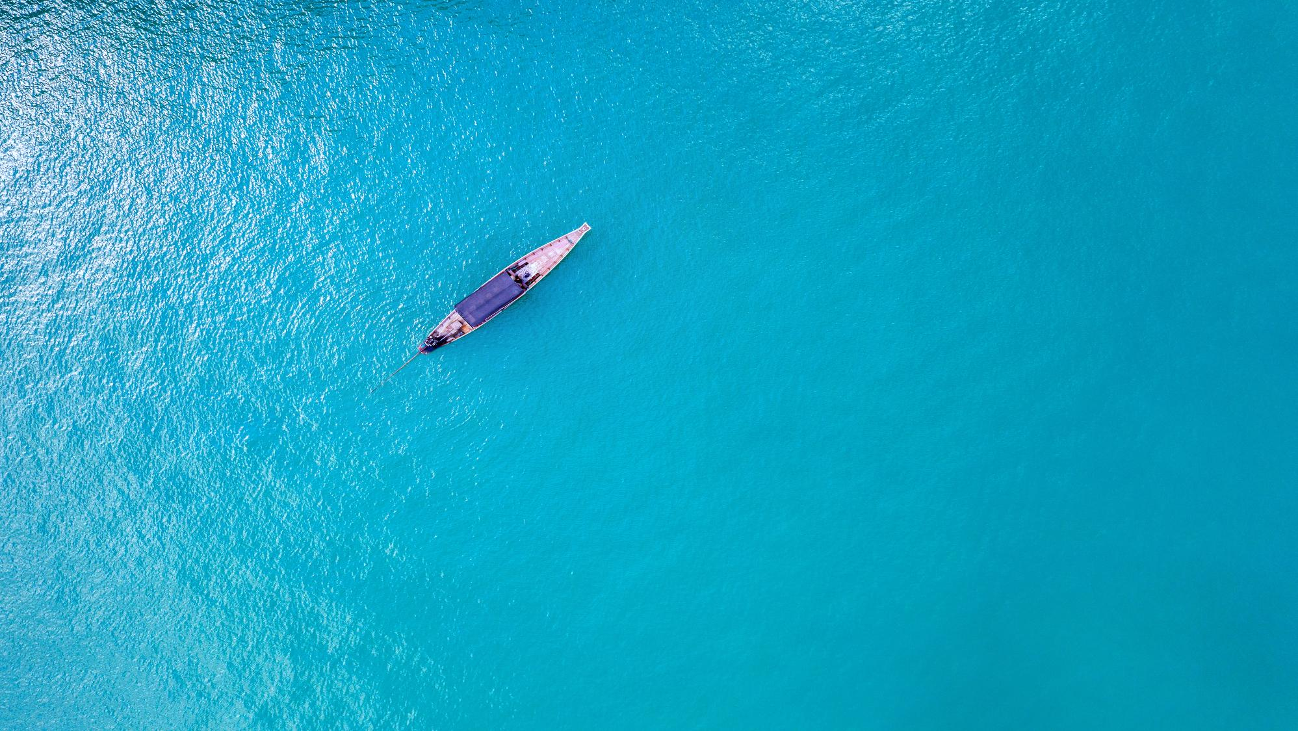
Data collection practices in small scale marine fisheries: Artisanal fisheries in Thailand
Weerapol Thitipongtrakul
Fishery biologist
Marine Fisheries Research and Development Division
Department of Fisheries of Thailand

Slide 2
Content
Introduction
SSF data characteristics
SSF data collection procedure
Limitation and challenges
Q&A
Notes:
This is the content of this presentation.
I will start with introduction then talk about SSF data characteristics, data collection procedure, limitation and challenges and Q&A session

Slide 3
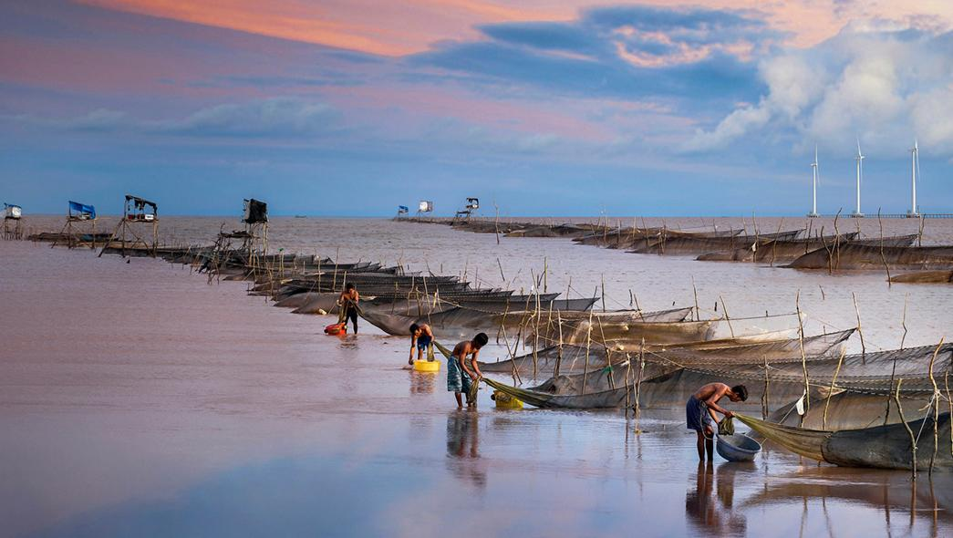
Introduction
What is Small Scale Fisheries (SSF)
Why it is important

Slide 4
Introduction
What is small scale fisheries (SSF)?
Regarding the FAO, SSF is
“Small-scale fisheries can be broadly characterized as a dynamic and evolving sub-sector of fisheries employing labour-intensive harvesting, processing and distribution technologies to exploit marine and inland water fishery resources. The activities of this sub-sector, conducted full-time or part-time, or just seasonally, are often targeted on supplying fish and fishery products to local and domestic markets, and for subsistence consumption. ….
Small-scale fisheries operate at widely differing organizational levels ranging from self-employed single operators through informal micro-enterprises to formal sector businesses…..”[1]
Ref: [1] https://www.fao.org/4/ae534e/ae534e02.htm
Notes:
There are many definition of Small Scale Fisheries (SSF) depending on countries. It is sometimes interpret as the word of artisanal fisheries.
However, regarding to the definition provided by the Food and Agricultural Organization of the United Nations (FAO), the SSF means……..

Slide 5
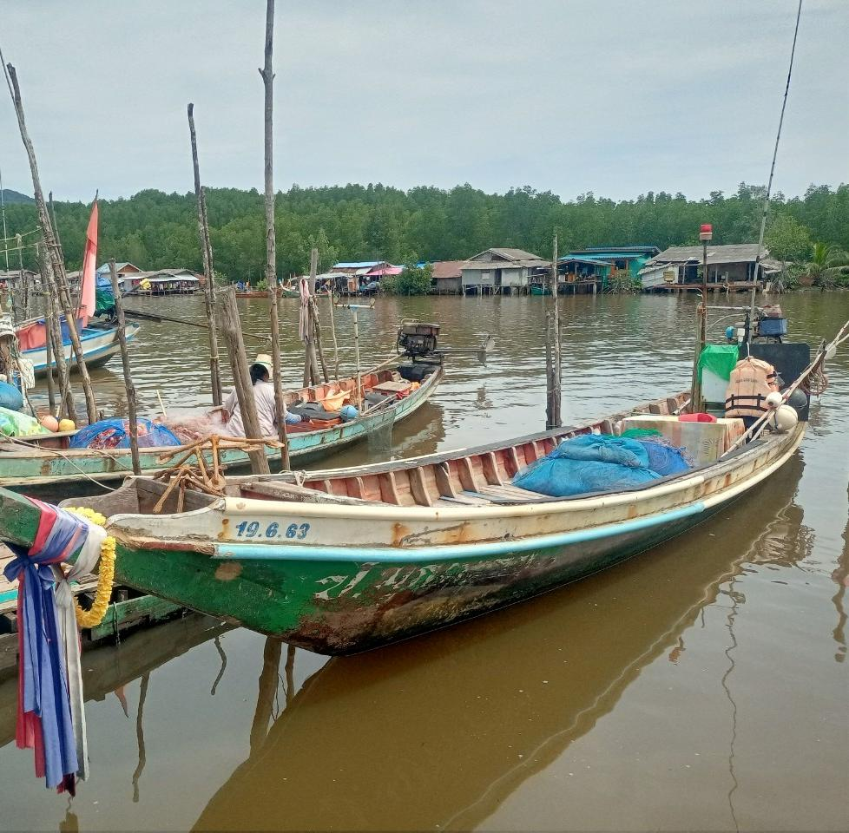
Introduction
Based on current fisheries legislation of Thailand, the Royal Ordinance on Fisheries B.E. 2558 and its amendments
SSF is defined as
“Artisanal fishing” means fishing operations in coastal seas in which a fishing vessel is used or without a fishing vessel, but in any case, does not include commercial fishing
Generally, it referred to
Vessels that size less than 10 GRT
Using low efficient fishing gears e.g. gill nets, traps, falling nets, etc (or gears which are not listed as commercial gears)
Usually operate in coastal area or beyond but not too far
Notes:
In Thailand, based on the current fishery law (the Royal Ordinance on Fisheries B.E. 2558 and its amendments), SSF or Artisanal fisheries means…….
The definition is generally referred to 3 conditions
1 .A fishery that use a vessel which less than 10 gross tonnage,
2. Using low efficiency fishing gears like gill nets, traps or pots, or other gears that aren’t listed as commercial gears. The commercial gears are mainly trawls and purse seine.
On the other hand, a gear that cannot catch large amount of fish in one haul.
3. A fishery that usually operating near shore and for 1 day fishing trip

Slide 6
Introduction
Why SSF is important
Even though SSF catch is low comparing to commercial fisheries, it critically contributes to
Local economy (mainly for local consumption and some are exported)
Endemic livelihood; Way of life in coastal communities
Affordable protein source with low prices
Job creation
Eco-tourism
Linkage in fisheries supply chain
SSF is a key element in upstream fisheries supply chain
Notes:
SSF catch is approximately 30% of the annual total catch in Thailand marine fisheries
Local economy, endemic livelihood, affordable protein source, providing jobs, community based tourism
SSF is an upstream element in fisheries supply chain that crucial to Thailand economy

Slide 7
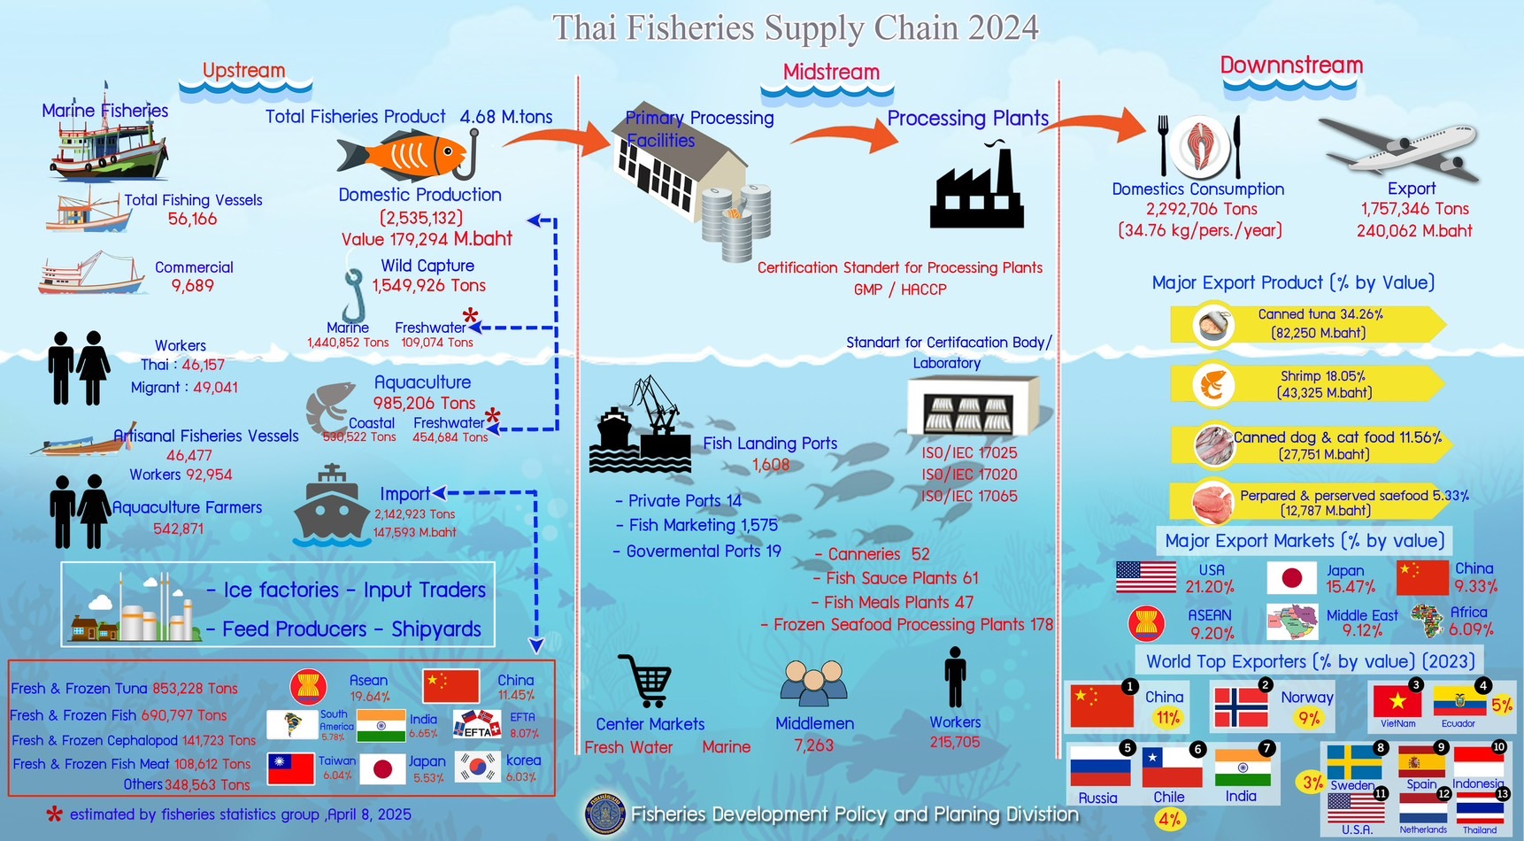
Notes:
One picture gives thousand words. This picture shows Thai fisheries supply chain in 2024. it was made by the fisheries statistic group, DOF.
You can see SSF [or artisanal fisheries here] in the yellow box on the left panel. The first huge numbers is vessel number and the second row is number of fishers involved in SSF.
There are many elements in upstream supply chain, including fishing vessels, fishers, related industries such as ice factories, feed producers, local traders and shipyard. Also imported raw fish for processing
The midstream includes processing plants, landing ports, middle man and marketing, storage facilities and etc. Some of you might know that Thailand is the largest tuna canning industry in the world. While Indonesia is the world largest raw tuna producer.
The downstream includes fishery products, end-users or consumers, and logistics

Slide 8
Introduction
Why we need to collect SSF data
All ASEAN member countries have SSF and it outnumbers commercial fishing vessels
However,
SSF data is usually excluded in fisheries management scheme due to sparse or limited
It is difficult to get SSF because of
Huge variety of fishing gears and methods
Indigenous fisheries
Seasonal fisheries
Usually landed in remote areas
No reporting system established

Slide 9
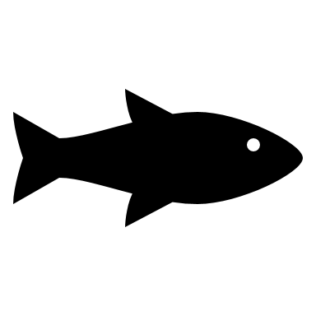
Introduction
Imagine that if 1-10 SSF vessels presented, it may use little fishery resources.
But what happen if they were increased 100 times (10,000 vessels), fish on the same resources and we do not know what exactly happen with the resources!?
Huge increased fishing effort ---> heavy stress on the resources
Therefore, data collection is needed to
Know what happened on the exploited fishery resources
Assess the status of fishery resources
Which resulting to the better resource management

Slide 10
Introduction
Enumerator
Fishing logbook
Port sampling
Fishing cooperatives/
Fishing associations
Comprehensive reporting system
All fishing information are recorded.
Ideal of data collection
fishing data and catch are recorded/manipulated by appointed local agencies. It has better data consistency than recording by individual fisher and could be done as routine reporting
Approaches for SSF data collection
An act to sample landed fishing vessels at landing sites. The fine details of fishing effort and what species in the catch are known
A document recording of fishing activities and catch.
logbook is preferable for routine reporting
Appointing somebody to record any fishing information
Notes:
This slide shows the approaches to collect fishery data. Start from the easiest one.
Start from the easiest one is appointing an enumerator to collect the data. It is limited only to the place that have an enumerator.
2. Using fishing logbook. The data got from this approach is based on what fishers recorded.
3. Port sampling. It is usually conducted by a technical team to get in-depth fishery data mor e than logbook.
4. Using cooperatives or association mechanism to record the fishing data. It has many benefits but difficult to handle if had more members
5. Using a comprehensive reporting system. It is integrated many method together. Anyway this is the ideal that all reporting scheme wish for.

Slide 11
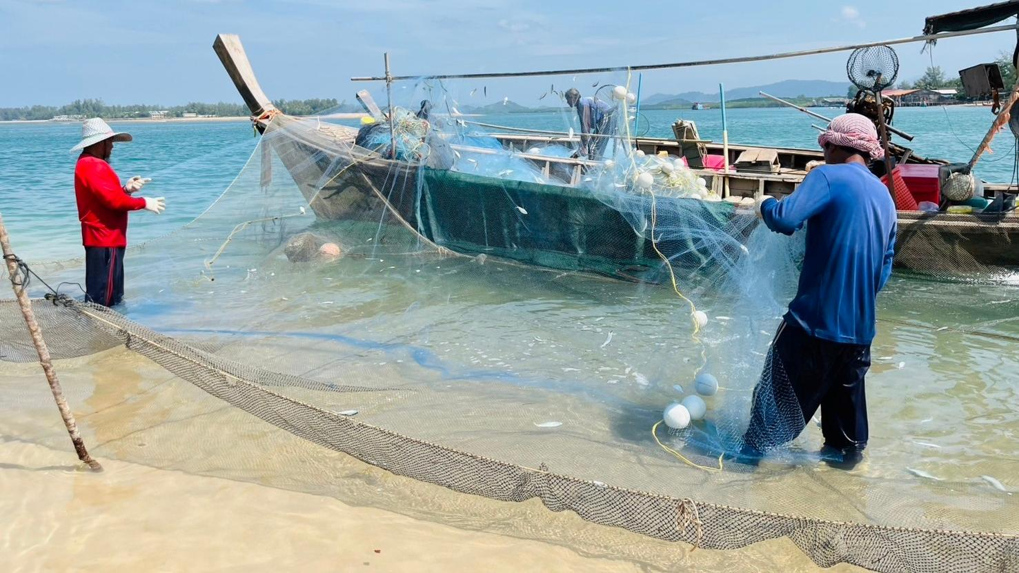
SSF data characteristics
Nature of SSF data is complexity especially in tropical area

Slide 12
SSF data characteristics
Complex and highly localize
Various fishing fears and fishing methods are used
Sparse and limited
Difficult to get SSF data
Multi-fisheries
Several species can be caught by a single gear at same time
Seasonal fisheries
Fishers tend to change their gears depend on monsoon or target species
Fishing knowledge passed down through generations
No proper recording established
Landed in remote areas
Mixed species in a catch
Notes:
It can be divided into 4 dimensions,
Complexity; due to various fishing gears and method used. Fishing technique and knowledge are pass downed in family through generations. It made SSF in each community unique.
Sparse and limited; due to it is difficult to get the data, that might be from difficulty in transportation, no recording system established, or not enough human resource for collect data
Multi-fisheries; many species can be caught by one fishing gear at a time and many type of gears can catch the same species
Seasonal fisheries: fishers changing their gears based on season or target species. It is different to commercial fisheries that rarely change the gears and method

Slide 13
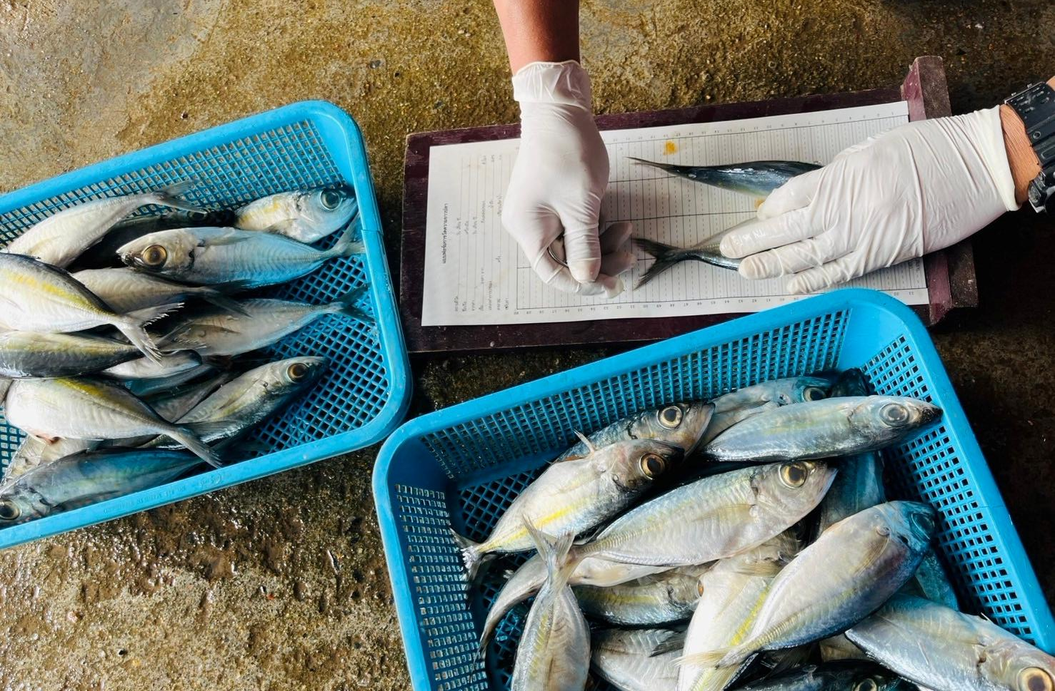
SSF data collection procedure
Different methods depend on country preferences
Notes:
Here comes the main element of this presentation
SSF data collection procedure
There are different methods depend on country preferences.
In the next slide will talk about the method used by DOF Thailand

Slide 14
SSF data collection procedure
A study case of Thailand
Two (2) approaches are used to collect SSF data in Thailand
1. Enumerator by appointing government officers to interview SSF catch in fishing communities/local fish markets
2. Port sampling at landing sites for scientific purpose
The data (from 2 methods) then analyze and comply to national fisheries statistics
The ultimate goals are to use for
Input in stock assessment
Research data
Supporting scientific evidences for legislation and fisheries issue/conflict resolutions
Notes:
There are 2 approaches to collect fisheries data in Thailand
By data enumerator
By scientific port sampling
The data of two sources are combined, analyzed and comply to fisheries national statistics and used in stock assessment or used as scientific evidences for issuing law or conflict solving

Slide 15
2
Statistic unit
Fishery data collection
Port sampling data from commercial and small scale vessels
Catch and effort
Catch composition
Independent survey by research vessel
Catch rate
Length of concerned species
Fish parameters
Length of concerned species
Research division
Research data
Supporting scientific evidences
1.1
Sources for national fisheries statistics
Single species stock assessment
3
Fisheries national statistics
4
1.2
Aggregated species stock assessment
Notes:
This is the flow chart of data usage for fisheries management. Please follow the number start from 1 to 4
Data collection of small scale and commercial fisheries. the 1.1 is the fishery dependent data and the 1.2 is the fishery independent data.
Analysis and primary output data. Catch and effort data are further used to comply national statistics
The processing data by the fishery statistic group. The overall catch and effort at national level are used in stock assessment
Stock assessment to know fishery status
The red boxes indicate the data used as scientific evidences/ conflict solving or stock assessment

Slide 16
SSF data collection procedure
The remaining slides will talk about scientific port sampling procedure done by DoF, which provide the details of
1. Fishing gear
2. Fishing method
3. Fine scale fishing effort
4. Fishing location
5. Catch composition at species level (or as finest as possible)
6. Some biological data of fish(sex, length, mature state)
7. Bycatch
Notes:
We are the half way. The remaining slides will talk about scientific port sampling procedure conducted by marine research division

Slide 17
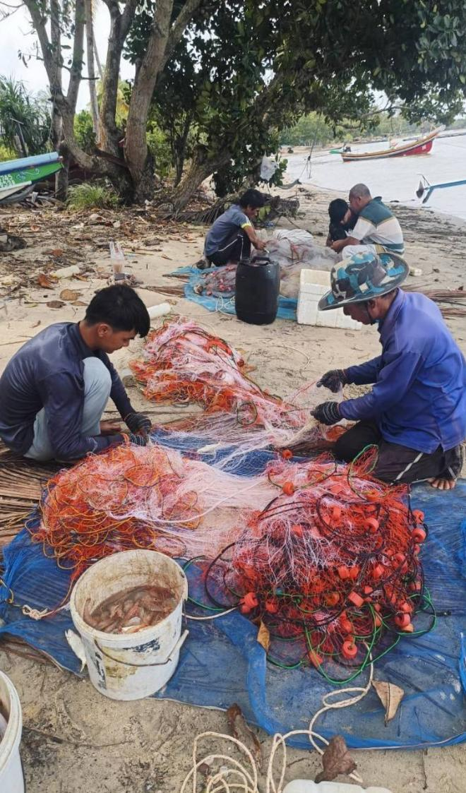
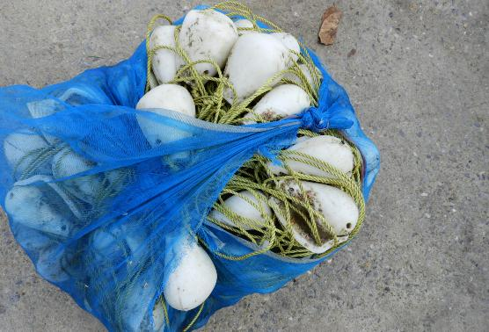
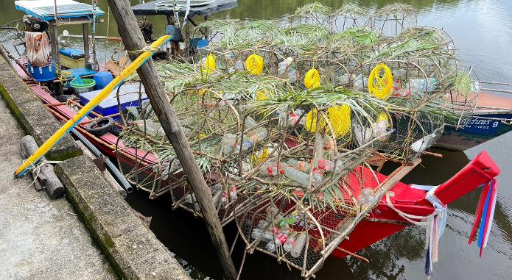
SSF scientific port sampling: sampling design
1. Stratified small scale fisheries into sub-group based on fishing gear
Gill net type
Trap type
Other gears, difficult to get data due to occasional fishing events and encounter
Notes:
First is the sampling design.
1. We should stratify the samples or grouping them to a larger group. It is for easier management,
SSF is stratify into 3 groups by gear types, which are gill nets, traps or pots, and other gears. The other gears are the fishing gears that difficult to get data due to occasional fishing events or very unique in the place. For example, jellyfish dipped net in eastern gulf of Thailand. this fishery occurred only short period of its bloom.
The pictures show some example of shrimp gill net and fish trap and octopus trap

Slide 18
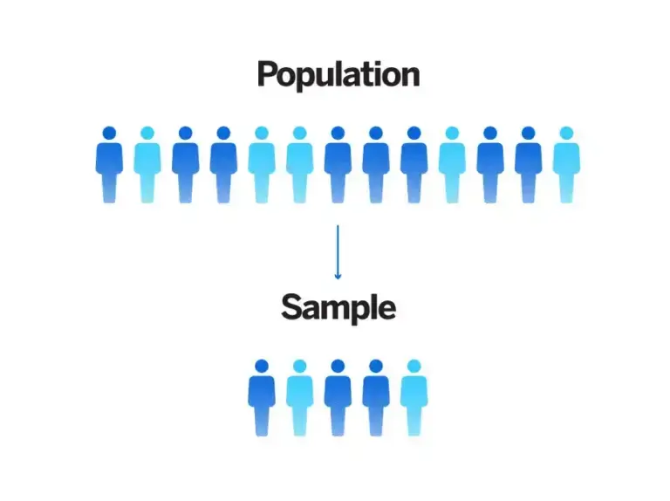
SSF scientific port sampling: sampling design
2. Determine sample size
Using formulas that incorporate the desired confidence level (e.g., 95%), relative error (precision), and variability (standard deviation) of the population parameter.
Commonly formulas;
Yamane’s formula[2] where know population number
Cochran’s formula[3] where population number is unknown
Setting minimum sample size of the total vessel number, 5%, 10%, ….?%
Ref: [2] Yamane, Taro. (1973), Statistics: An Introductory Analysis. London: John Weather Hill, Inc.
Ref: [3] Cochran, W. G. (1977). Sampling techniques. 3 rd Ed. New York: John Wiley & Sons
Notes:
2. Determine how many sample we have to sampling. It has many way to do.
For example, using formulas that incorporate the desire criteria like confident level, error, or variability
The famous formula are Yamane’s formula and Cochran’s formula. Please look for its condition before using.
Determine the minimum sampling size of the total vessel number. 5%, 10%, ??% or 50% if possible!???

Slide 19
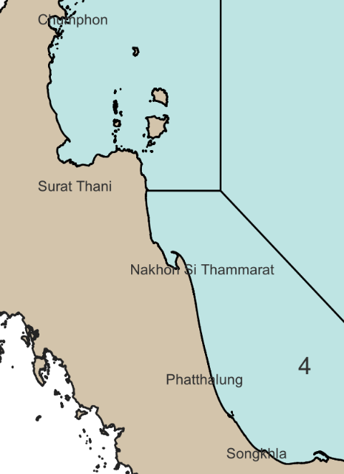
SSF scientific port sampling: sampling design
3. Location selection (landing spots)
It should be represented/distributed the fishery in the area
4. Time scale
Should reflect temporal variation of the fishery
Fishers may change fishing gear depend on season (mainly influence by monsoon)
Normally on monthly basis or quarterly or depends on circumstances
Notes:
3. Determine landing site; this should represent the fishery in the interested area. For example, if we want to collect fishery data fish in the area in the right picture, the sampling spots should be distributed along the coastline.
4. Determine time scale; it should reflect variation of the fishery. Normally on monthly basis.

Slide 20
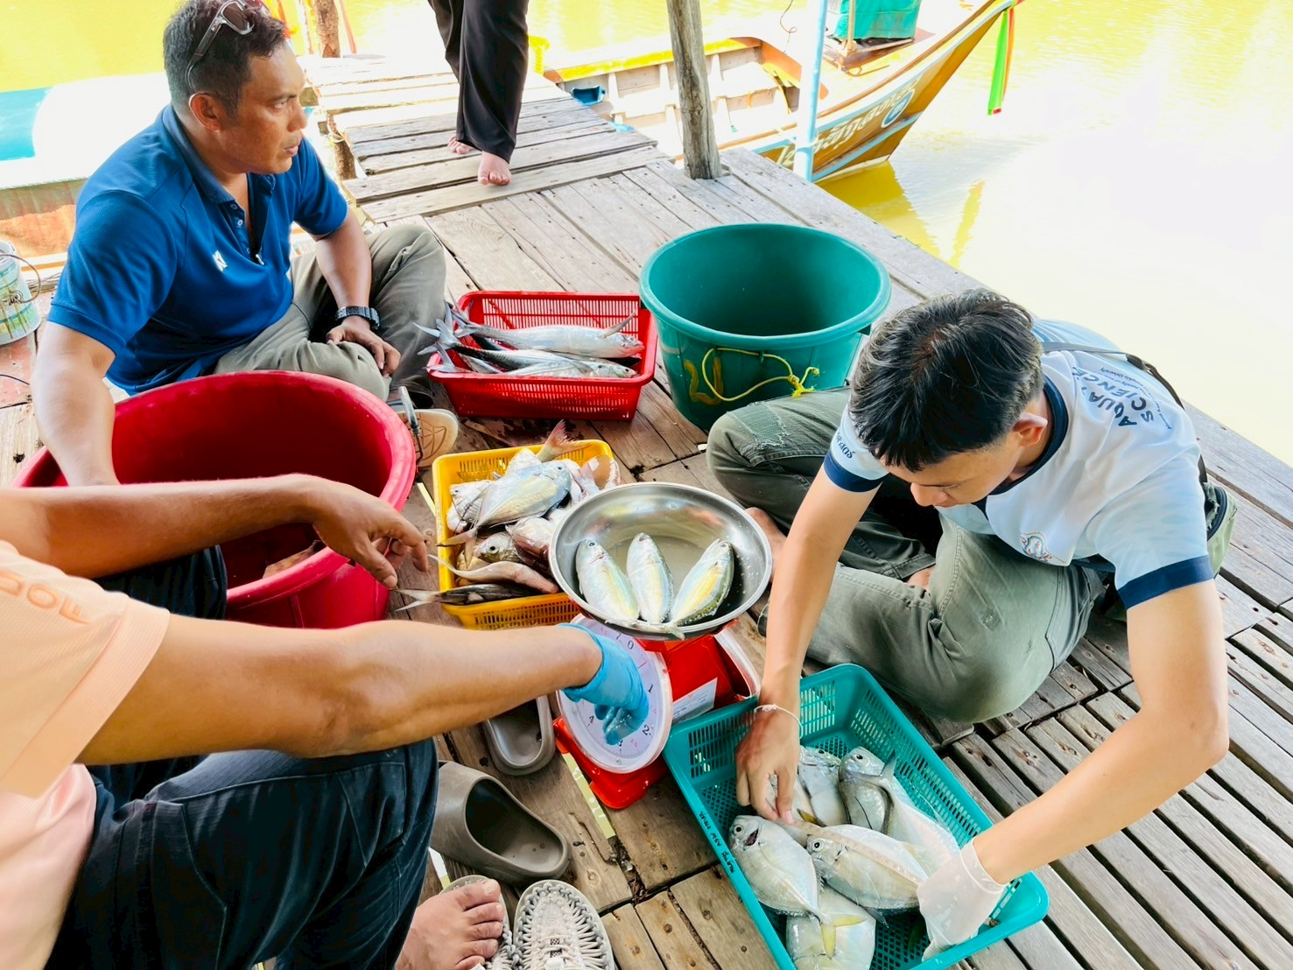
SSF scientific port sampling: sampling design
5. Practically, accidentally sampled landed vessels at the selected landing sites
It is difficult to specifically sample desired fishing gears, or cannot know which vessels will be landed.
Various fishing gear used in a fishing village
Notes:
5. The sampling will carry on accidentally sampling basis at the selected sites
This is because it is difficult to sample desired fishing gears due to we do not know which vessel will be landed.

Slide 21
SSF scientific port sampling: sampling procedure
Fishery data is collected with 2 methods
1. Interview fishers
Fishing hour
2. Catch sampling
Sub-sampling the noticeable catches (especially groups of target species) and discards
Fishing location
Some gear characteristics and fishing methods
Bycatch information
Economic information (additional data)
Collect biological data of concern species
Notes:
Comes to sampling procedure
There are 2 steps of collecting data,
1, interviews fishers for fishing effort, fishing ground, fishing gear characteristics, also economic data if possible.
2. Sampling the catch to know species composition.
Fishers usually categorized their catch onboard or before selling such as good pelagic fish, good condition shrimp or low-valued fish. This is for higher selling price. Sub-sampling these catches and collect fish biological data

Slide 22
SSF scientific port sampling: sampling procedure
Interview templates are recommended for consistency of the data
Information may be different by fishing gear
However, the key elements must be same i.e.
Sampling date
Date of fishing trip
Vessel info
Fishing gear used
Record of fishing activity/effort (number of hour, number of pot, total net panel length, soaking time)
Fishing location (fishing coordinates if possible)
Gear characteristics (optional); can be separately collected
Notes:
In interview process, the interview template is required for consistency of the data

Slide 23
SSF scientific port sampling: sampling procedure
Catch sampling is purposely to get catch composition and fish biological data
Sub-sampling the noticeable catches (especially groups of target species) and discards
This is need to identified to species level or as finest taxonomic level as possible
Inspect and record bycatch (if found)
Family level
Rough identification
Genus level
Better identification
Fish have some different characteristics within “genus level”
Species level
Good identification
Very useful to management
Better than nothing

Slide 24
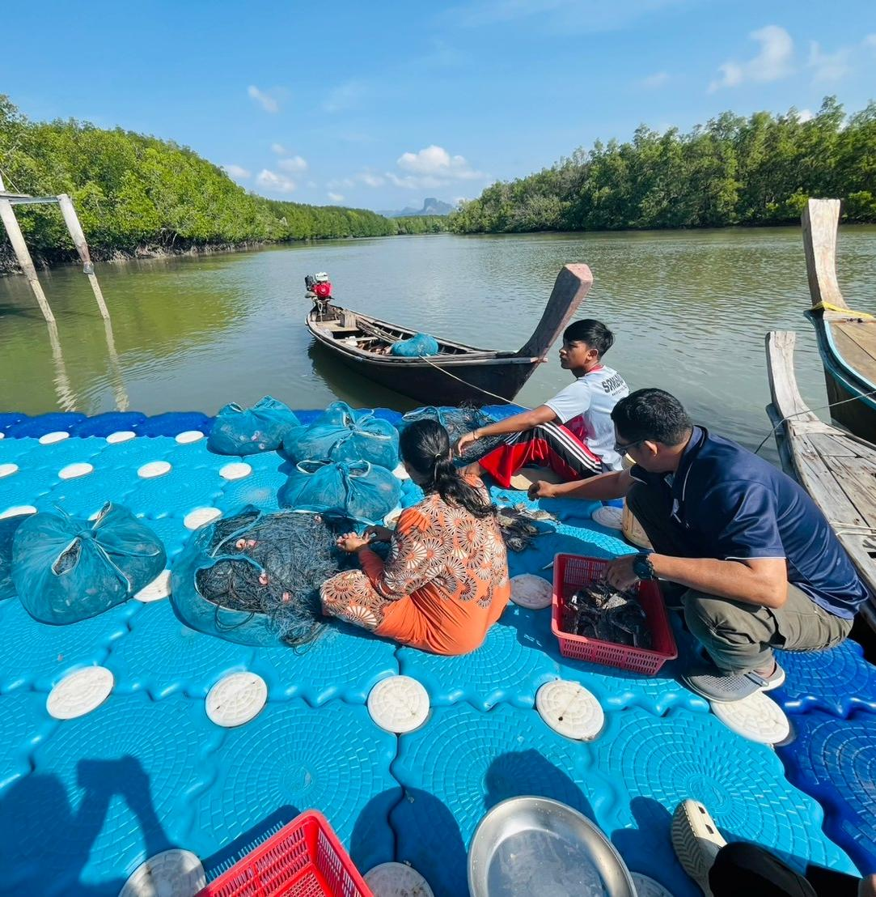
Interviews fishers at landing sites when finish landing their fishes or whenever they free or available
Some are friendly cooperate
Some are refuse
Some are in hurry
Sometime we can interview his boss instead (wife)
Notes:
This picture shows atmosphere during the survey

Slide 25
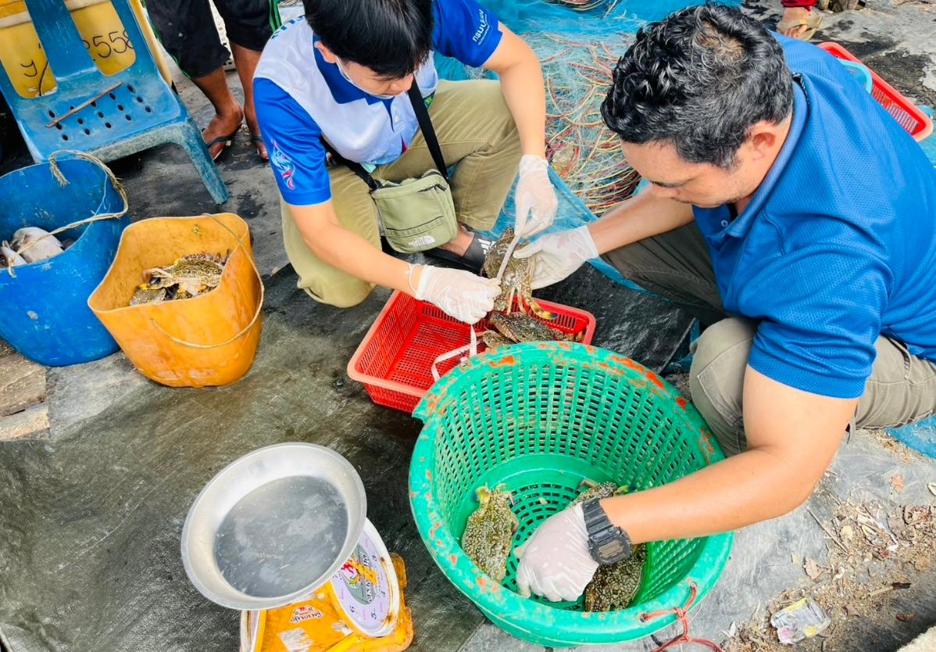
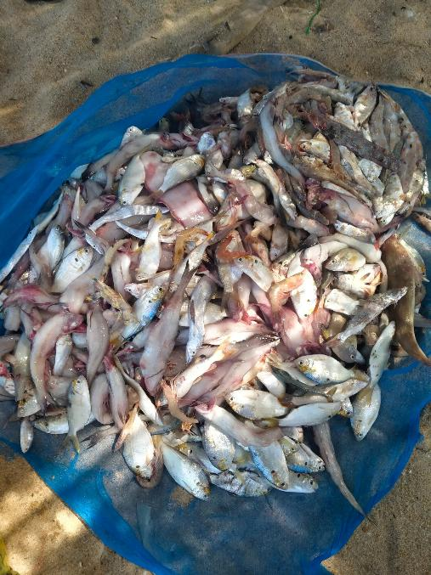
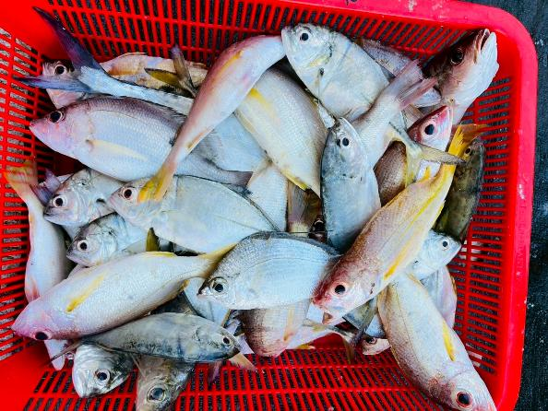
Sampled the landing catch to determine catch composition and collect some biological data
Landed catch usually categorized into market fish (valued fish) and unwanted fish (discarded or trash fish in some cases)
Notes:
The pictures show atmosphere during the survey

Slide 26
SSF scientific port sampling: sampling procedure
Collect biological data of concern species For example,
Length
sex
Maturity stages
Others e.g. tissue for DNA analysis, othliths (for specific researches)
The biological data is the important element for stock assessment
Fish of each stock have unique characteristics
High or low growth rate depends on environment they live
Various mortality rate in different life stages. Larvae have high mortality rate than adults.
Length is basic parameter that need to be collected. “WHY?”
Notes:
For biological data collection, there are many concerned parameters to collect. For instance, length, sex, maturity stage, tissue for molecular analysis.
Amount these, length is the basic parameter that need to collect. But WHY?

Slide 27
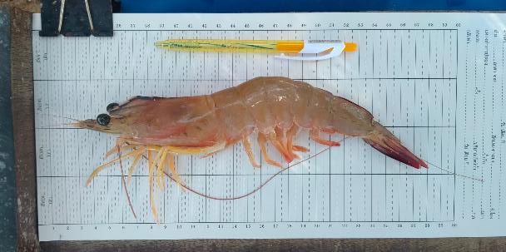
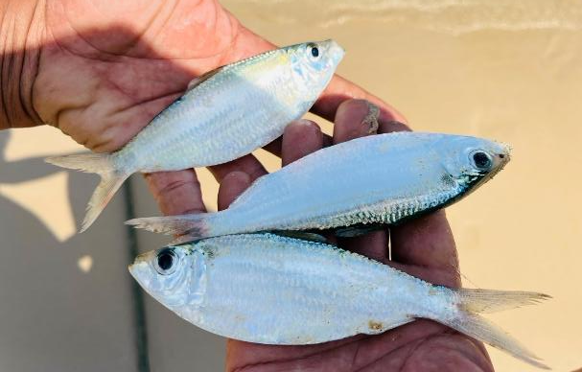
SSF scientific port sampling: biological data collection
Why we are focusing on LENGTH
The other biological data are also important but length is not difficult to collect during survey
Length is important in stock assessment as it reflects several things on the resources
It is used to determine fish biological parameters such as
Constants in length-weight relationship (a and b parameter)
Asymptotic length (Linf)
Curvature parameter (K); aka, growth parameter

Slide 28
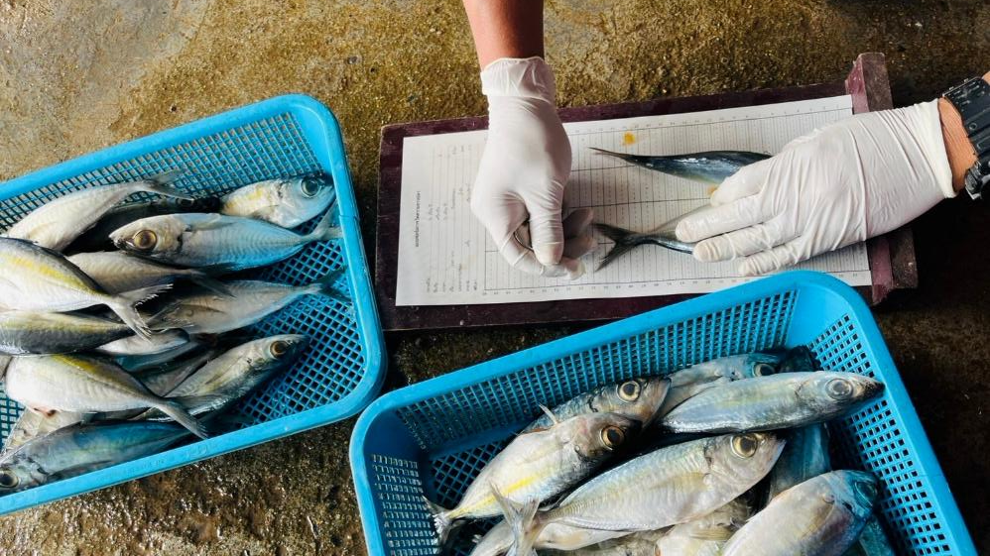
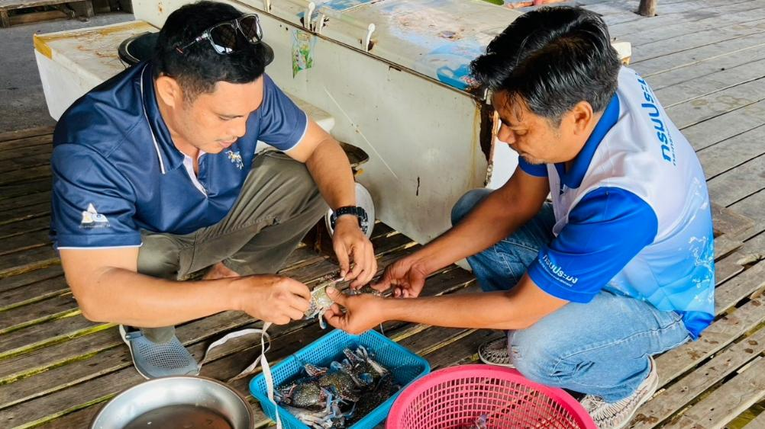
SSF scientific port sampling: biological data collection
Length measuring
Measuring method varies by species
Punching paper, flexible tape, rulers, etc.
Different length type is appropriate for certain species
Total length (TL),
Fork length (FL),
Lower jaw-fork length (LJFL)

Slide 29
SSF scientific port sampling: after field survey
Input collected data into digital files which will be convenient to do further analysis
Generally using spreadsheets in MS Excel
The database application builded purposely for data collection such as MS Access, ODK collect, Kobo toolbox, etc. is preferable
Notes:
After got the data in field survey. We need to record it in a suitable place.
The powerful and convenient one is in excel spreadsheet. It is convenient for further analysis
The other data collection applications are also recommended

Slide 30
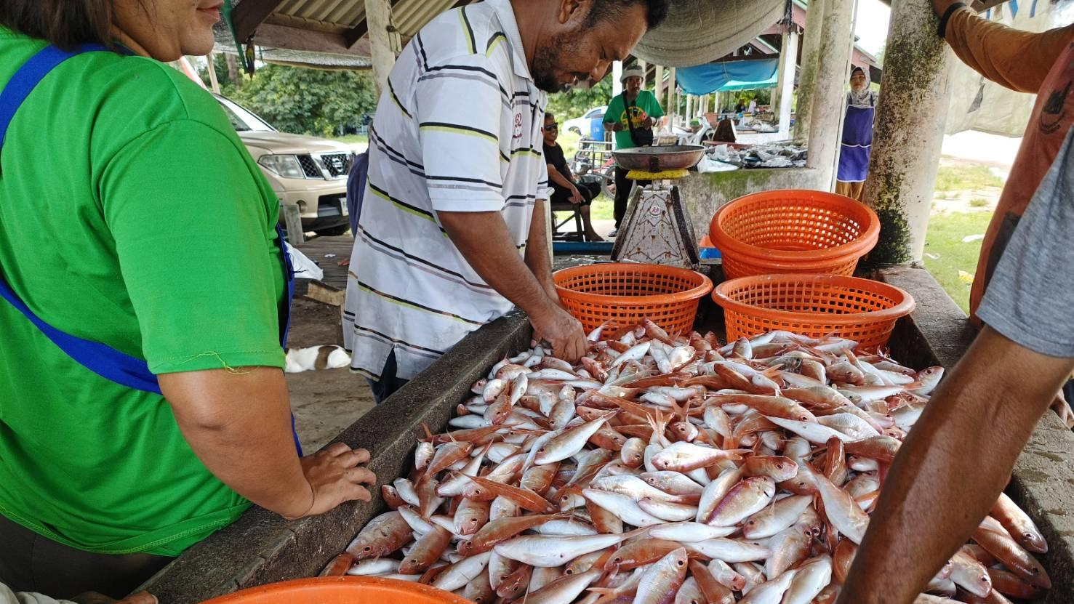
Limitation and challenges
Every data collection methods have limitations
Knowing the limits can have a plausible collection plan
Notes:
The last section of this presentation
Everything is not perfect.

Slide 31
Limitation in SSF data collection
There are key limitations needed to be considered
1. Port sampling may not cover all SSF
Laborious work to do if have large sample size, even more difficult if there are many indigenous fisheries and many landing spots
Need time and budget
2. There is an issue in data consistency across SSF data set collected by several collectors/enumerators
Notes:
Every collector has his/her own bias, which usually reflect in collected data. For example, some collectors fill all data in a template but some might not. This will cause errors when data were combined together.

Slide 32
Limitation in SSF data collection
3. The collectors (also enumerators) have to possess good taxonomic skill in order to proper identify found fish into species level
4. In term of self reporting using logbook, fishers might not willing to cooperate as they think it is encumbrance (or annoying) due to
It is complicated for them
Many information to put in logbooks
Difficult/not convenient for them to write/record
Tired after fishing works and not willing to do
Etc.

Slide 33
Challenges to improve data collection
Many challenges are open for data collection improvement especially;
1. The routine data reporting scheme should be established, managed by
Government agencies -> top-down approach
Fishing communities -> bottom-up approach
Fishing cooperatives/association -> bottom-up approach
2. Initiation by government side could induce participation of fishers
Introduction of simple logbook for SSF
Logbook recording on voluntary basis
“The cooperation from fishers is the key of success”
Notes:
Turning to challenges

Slide 34
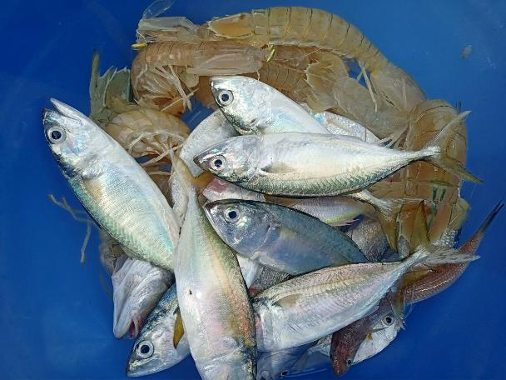
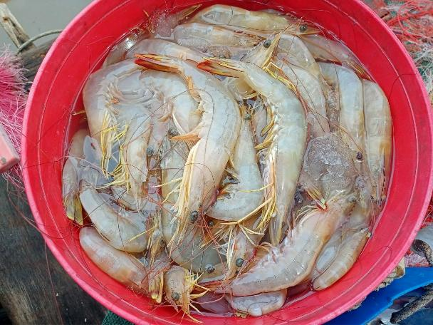
Challenges to improve data collection
3. Improving taxonomic skill of data collectors also important
It is better confident in fisheries management if data were collected at specie level
It is a big challenge due to it is based on individual passion and take time to accumulate the skill

Slide 35
Conclusion
Port sampling might be a good start for SSF data collection at situation which difficult to establish a reporting system (at least for scientific proposes)
However!!
By increasing human[man]power and budget, we will get more SSF data
BUT Is it last? For 2 year? For 5 year? forever or never?
The other way of collect SSF data for fisheries management can be focusing on specific fisheries or the specific management goals, at;
A fishery that has economic important, or
A fishery that reflects changes of exploited resources in the area (indicator fishery), or
A fishery that fish on species that a key species to ecosystem (indicator species), or
Any possible ways? Any ideas?

Slide 36
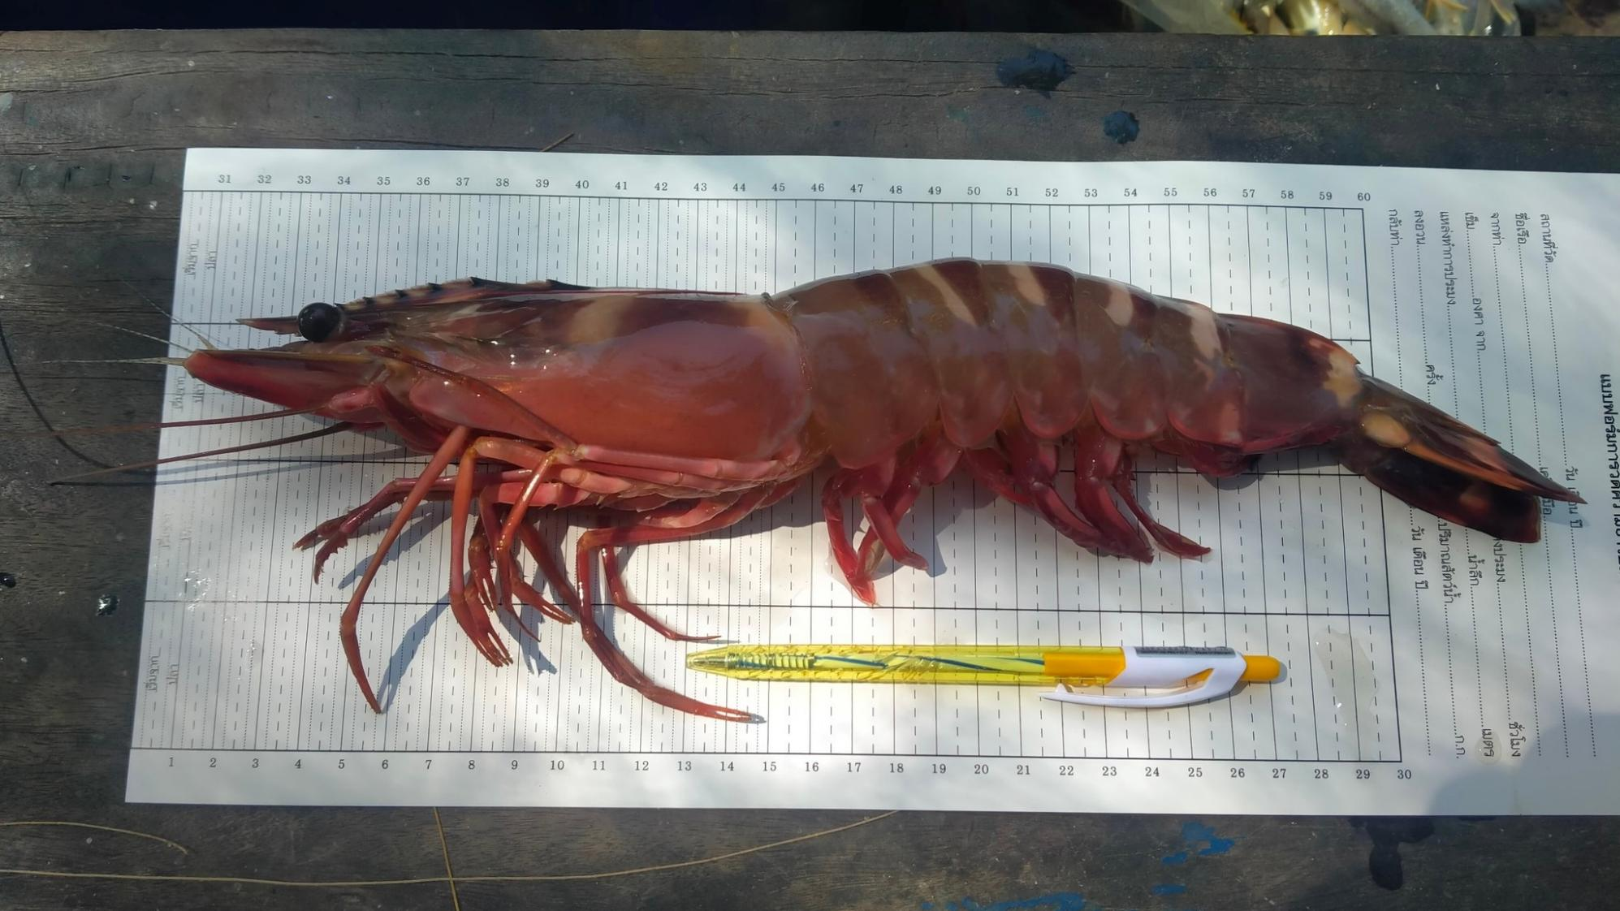
Thank you for your attention
Any questions are welcome!!

