Slide 1
BRUNEI DARUSSALAM COUNTRY REPORT
Workshop and Study Visit on Small-scale Marine Fisheries Data Collection
14th–17th July 2025
Bangkok, Thailand

Slide 2
SMALL-SCALE FISHERIES OF BRUNEI DARUSSALAM
The fisheries sector plays a significant role in the national economy, with the capture fisheries industry continuously contributing about 83% of the country’s supply of fish.
Small-scale fisheries play a critical role in local fish production, contributing about 81% to the capture fisheries industry

Slide 3
CHARACTERISTICS OF SMALL SCALE FISHERIES OF
BRUNEI DARUSSALAM
TYPE OF BOAT:
WOOD OR FIBERGLASS
PROPELLED BY ONE OR TWO OUTBOARD ENGINES
NETS
HOOKS AND LINES
POTS
FISHING GEARS:
FISHING GROUND:
ZONE 1 (0-7NM FROM SHORE) AND ABOVE

Slide 4
SMALL-SCALE FISHERIES OF BRUNEI DARUSSALAM
FULL-TIME FISHERS
PART-TIME FISHERS
SMALL-SCALE COMPANIES
Livelihood of the fishers depends entirely on fishing activities
For sale purposes and own consumption
Fishing activities carried out on a part-time basis (during free time/ weekend)
Own consumption
Fishing activities by small-scale fishers registered as companies
For sale purposes

Slide 5
CURRENT MECHANISMS FOR DATA COLLECTION IN SMALL-SCALE FISHERIES
Monthly data forms - issued by DOF and
distributed manually to fishers
Fishing Operation
Date of operation
Location of Operation
Species of Fish Caught
Weight of Fish Caught
Through social media
Market
Price per Kg
Sales Revenue
Expenses
Random sampling - daily visit to stalls and slipways

Slide 6
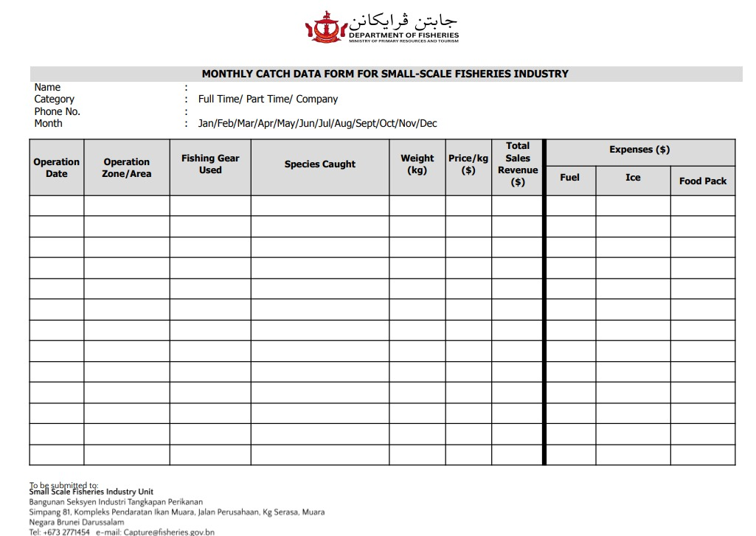
MONTHLY DATA FORM

Slide 7
CHALLENGES IN THE SMALL-SCALE FISHERIES OF
BRUNEI DARUSSALAM
CHALLENGES | PROGRESS
Low Data Reporting Coverage Less than 5% of the total fishers' data is collected through the existing data collection methodology. | Establishment of Electronic Catch Documentation Scheme (ECDS) which is directly connected to a central database for improved traceability and management. Estimated implementation timeline: By end of 2026
Fragmented and Dispersed Fishers Over 30 slipways used by fishers in various locations, making monitoring difficult Fishers who live in the Water Village typically do not use slipways - posing additional challenges to access and data collection | Establishment of Electronic Catch Documentation Scheme (ECDS) which is directly connected to a central database for improved traceability and management. Estimated Implementation Timeline: By end of 2026
Insufficient Manpower & Resources Limited field officers for data collection and monitoring | Establishment of Electronic Catch Documentation Scheme (ECDS) which is directly connected to a central database for improved traceability and management. Estimated Implementation Timeline: By end of 2026
Limited Digital Access & Literacy Some fishers lack digital skills | DOF will guide on the use of ECDS after its establishment
Limited Trust and Engagement Hesitancy to share information due to lack of incentives or awareness | DOF has conducted various initiatives to support the small-scale fisheries industry

Slide 8
DEPARTMENT’S INITIATIVES FOR SMALL SCALE FISHERIES
SOCIOECONOMIC SURVEY
CAPACITY BUILDING TRAINING
Survey conducted at fisher households, slipways, and fish markets to understand the livelihoods of fishers and serve as a platform for data collection.
To increase skills and knowledge amongst fishers on engine diagnosis and maintenance as well as the use of GPS & Fish Finder.
UPGRADING OF SLIPWAYS
ROADSHOW/AWARENESS PROGRAMS
FISH STOCK ENHANCEMENT PROGRAM
To increase awareness and serve as a platform to raise and address issues.
Deployment of Artificial Reefs to enhance stock and create new habitats.
Upgrading slipways to improve facilities and infrastructure for the safety of fishers and support more efficient operations.
FISHERMAN DAY 2025
MOBILE LICENSE COUNTER
To celebrate and appreciate fishers' contributions through activities such as artificial reef fabrication and deployment programs.
New initiative to increase the number of licensed fishers through improved outreach and accessible services

Slide 9
THANK YOU!
+673 277 1454
capture@fisheries.gov.bn
www.fisheries.gov.bn
DEPARTMENT OF FISHERIES
Ministry of Primary Resources and Tourism
Muara Fisheries Complex
Simpang 287-53,
Jalan Peranginan Pantai Serasa,
Muara BT1728, Brunei Darussalam

