Slide 1
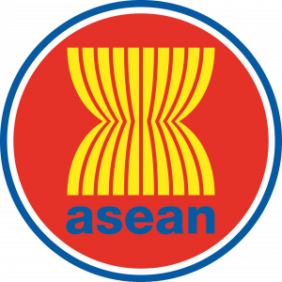
Status and Challenges of Small-scale Fisheries in Indonesia
Prepared for Workshop and Study Visit on Small-scale Marine Fisheries Data Collection for Fisheries Management in ASEAN
Directorate for Downstream Planning and International Economic Cooperation
The Ministry of National Development Planning/National Development Planning Agency
Republic of Indonesia
Notes:
Status and Challenges of Small-scale Fisheries in Indonesia

Slide 2
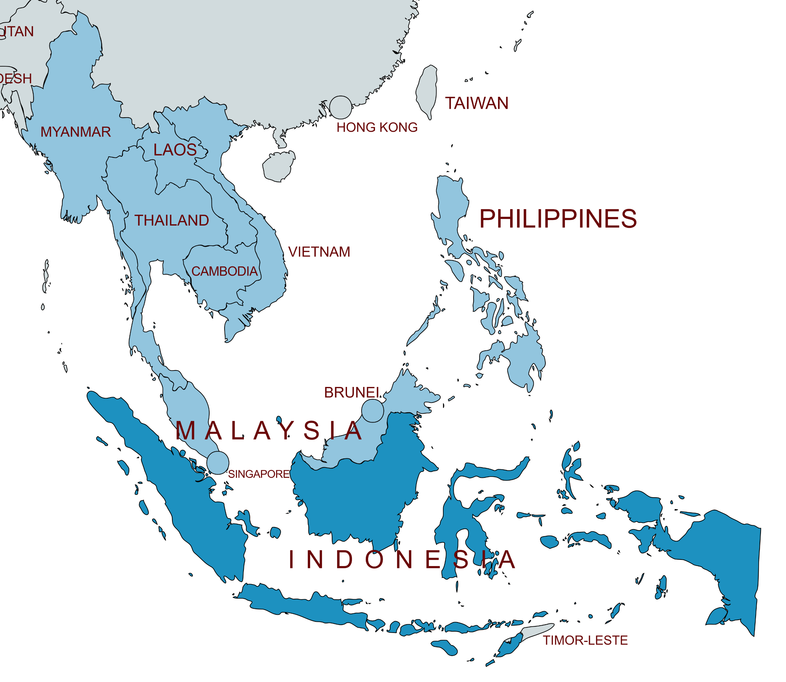
ASEAN is home to one of the world's largest marine and fisheries wealths, as well as the largest population that relies on it
ASEAN Exports (% to World Exports) by HS Code
Over one-fifth of global exports of processed fish and crustaceans (HS 1604 and HS 1605) originate from ASEAN, although this tendency has been gradually decreasing during the past two decades.
03 Fish and crustaceans, molluscs and other aquatic invertebrates
1603 Extracts and juices of meat, fish or crustaceans, molluscs and other aquatic invertebrates
1604 Prepared or preserved fish; caviar and caviar substitutes prepared from fish eggs
1605 Crustaceans, molluscs and other aquatic invertebrates, prepared or preserved (excl. smoked)
2
Indonesia's marine resources include 37 percent of the world's fish species.
7
10
9
The entire assessed potential of fish resources in Indonesia's 11 State Fisheries Management Areas is 12.0 million tons per year, with a total permissible capture of 8.6 million tons.
1
3
4
6
8
90 percent of the Marine and Fisheries Business Actors in Indonesia are MSMEs
5
11
Trademap, 2024
Coordinating Ministry for Maritime Affairs and Investment Republic of Indonesia, 2020
Ministry of Marine Affairs and Fisheries, 2022
Statistics Indonesia, 2024

Slide 3
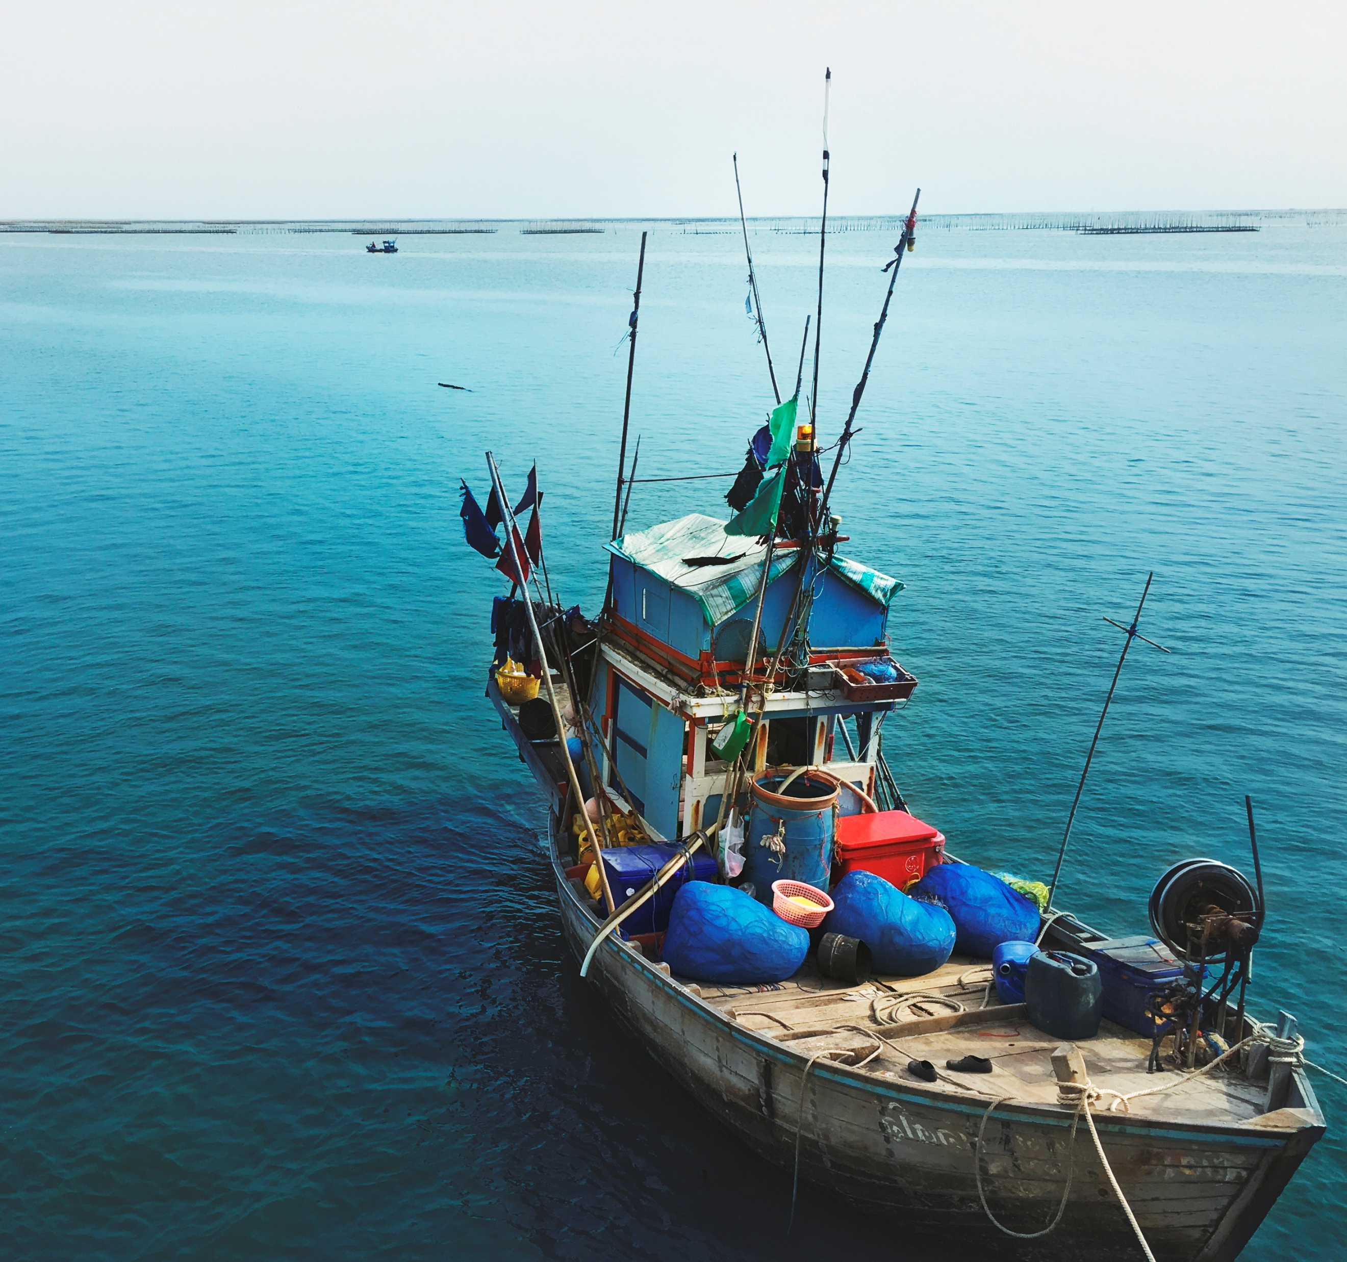
However, various challenges are still faced and have a direct impact on the welfare of vulnerable communities.
Climate Change
Increase in seawater temperature, ocean acidification, and sea level rise
Insufficient skills and expertise among fishers, coupled with a significant lack of education
skills in navigation, sustainable fisheries management, seafood processing, business management, marketing, and technology that can improve their productivity and competitiveness.
Threaten livelihoods, worsen poverty, and raise food insecurity
Marine Pollution
53 million metric tons of plastic waste will pollute global aquatic ecosystems by 2030
Overfishing, Illegal, Unreported and Unregulated Fishing
Indonesia is ranked 6th lowest out of 152 countries in dealing with IUU Fishing, with a score of 2.89 point
Conflict over Space Utilization
Disparity in the utilization of marine space among sectors, including fishing, tourism, transportation, and industry
Inadequacies in infrastructure and technology
Limited access to electricity, clean water, and adequate transportation systems
Degradation of the Marine Environment
use of destructive fishing gear, mangrove deforestation,
Statistics of Indonesia, 2024

Slide 4
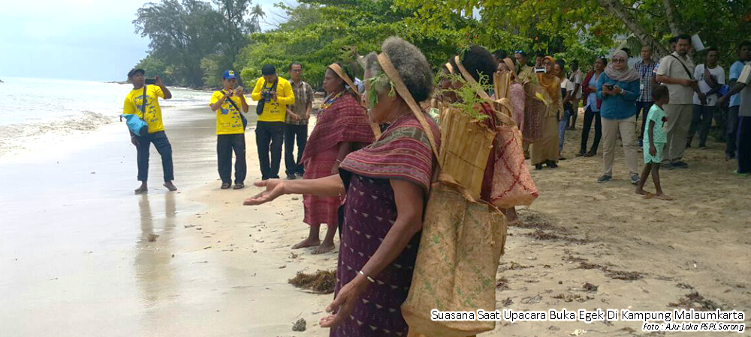
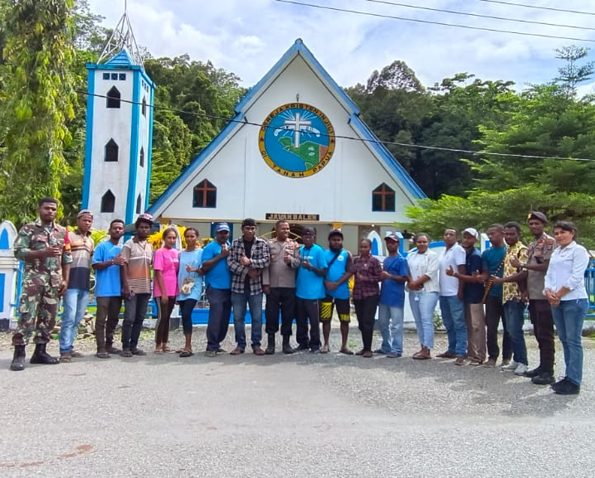
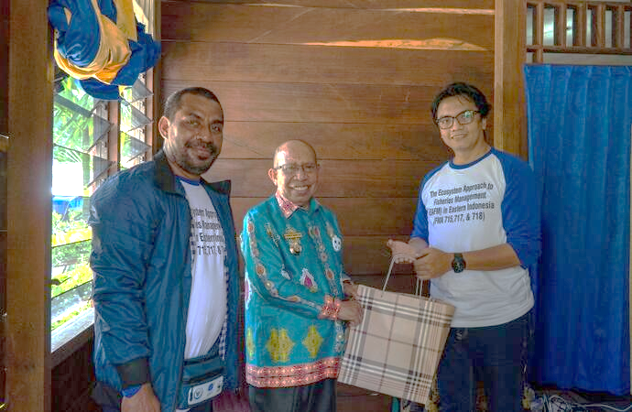
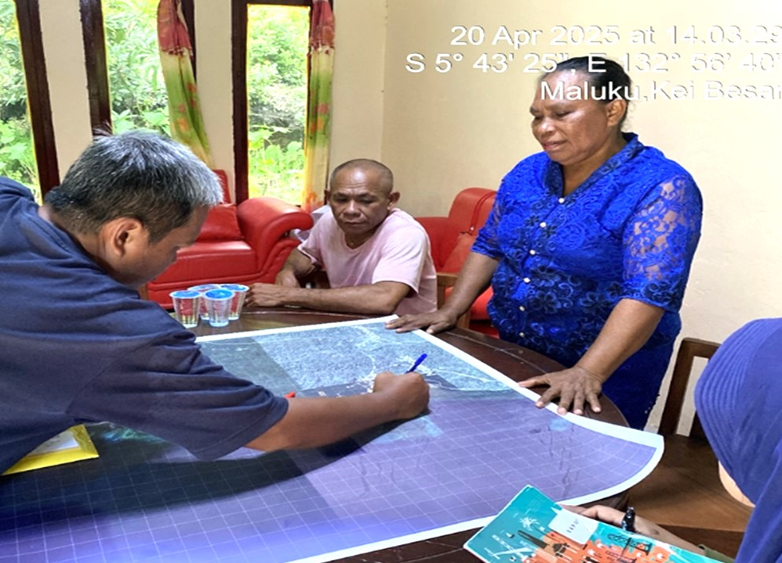
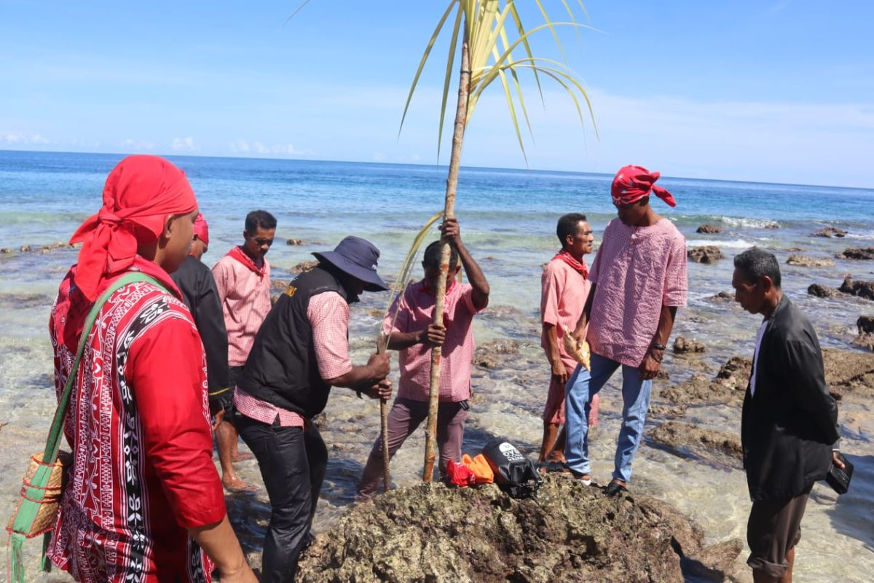
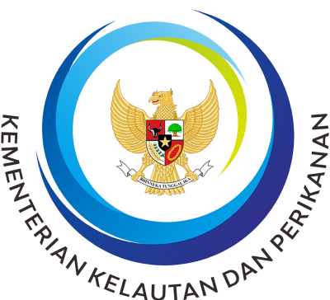
To protect marine ecosystems and uphold cultural values, the Indonesian government supports the revitalization of the 'Sasi' customary law from Eastern Indonesia
Sasi is a customary law that restricts the use of natural resources to support conservation and fair distribution within the community.
It reflects local norms and taboos that guide responsible resource management.
Practiced widely across Maluku and Papua, sasi functions as a form of indigenous governance rooted in environmental and social accountability.
The Sasi Co-Management, rooted in Eastern Indonesia’s traditional Sasi system, integrates the Ecosystem Approach to Fisheries Management (EAFM) to promote sustainable fisheries through capacity building, mapping, legal recognition of customary communities, and the designation of Sasi areas as OECM conservation sites.
Implemented in WPP 715, 717, and 718, this approach supports conservation expansion by empowering local and indigenous stakeholders to manage ecologically important areas outside formal protected zones.
Sasi Label is an eco-labeling innovation for fisheries and commodities sourced from marine sasi areas.
It aims to add economic value to these products and encourage communities to manage fisheries using an ecosystem-based and sustainable approach.
Locations: Watkidat, Ohoideratwan, Aisandami, Menarbu, Kilitay.
Replicated in: Waho, Laha, Samber Binyeri, Daeo Majiko, and Citius.
CFI Indonesia, 2024
Notes:
Other Effective Conservation Measures
WPP : Fisheries Management Area

Slide 5
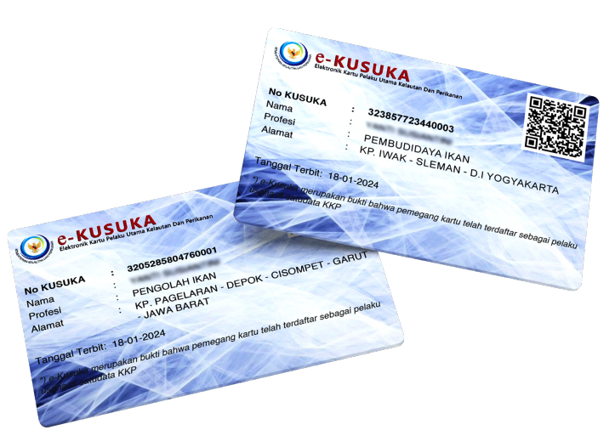
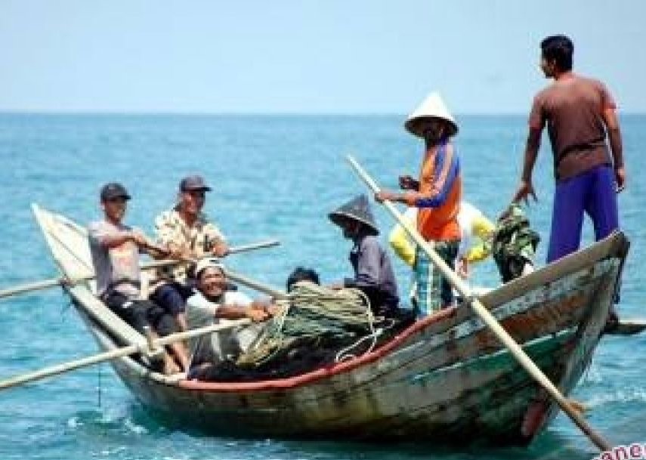
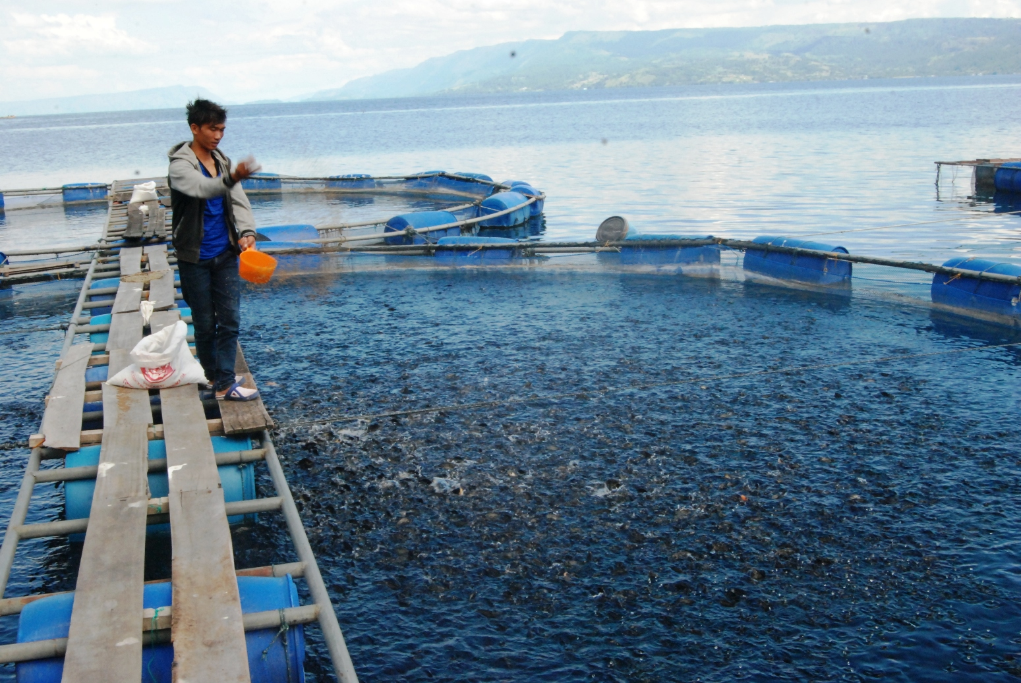
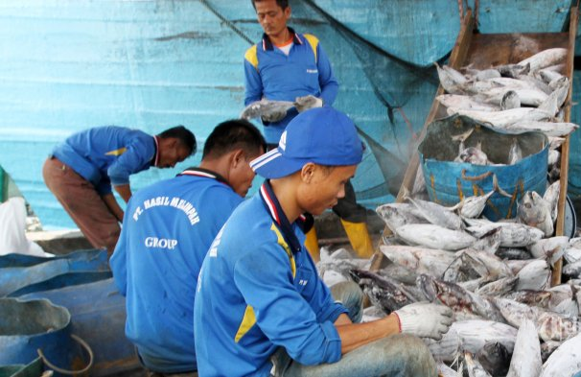
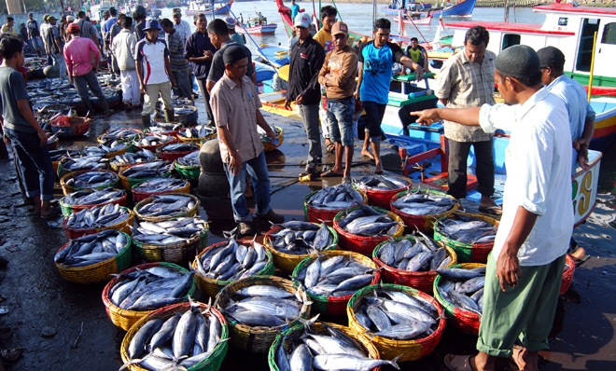
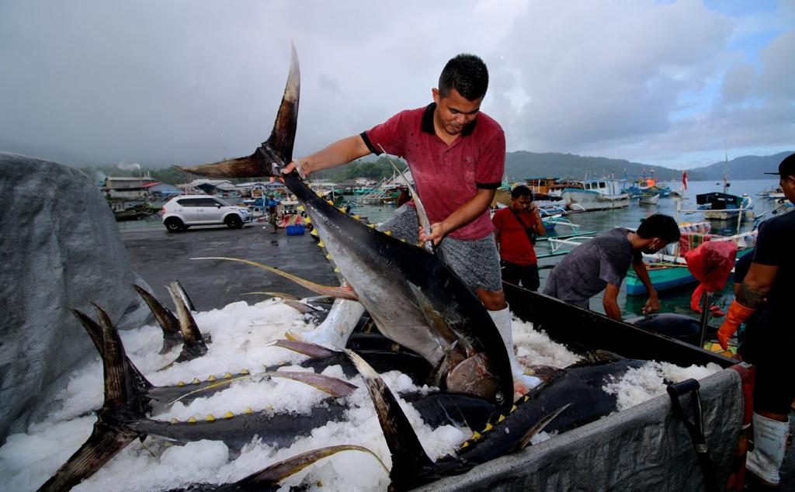
The Ministry of Marine Affairs and Fisheries created the KUSUKA program to record Fisheries Business Actors
The Distribution of Business Actors Registered in KUSUKA (by business type, entity, and province), July 2025
Individual
1.720.747
Business Entity
4.571
Card for Marine and Fisheries Business Actors (KUSUKA)
Official identity for business actors in the marine fisheries sector as a national database and makes it easier for business actors to access government programs.
Identity: Integrates all fisheries business actor cards into a single card and consolidates stakeholder data for cross-unit use and inter-agency collaboration.
Protection: Serves as a prerequisite for accessing social assistance (BPAN) and insurance schemes such as fisheries and salt farming insurance.
Empowerment: Required for receiving assistance from technical units and applying for credit through Marine and Fisheries Business Capital Management Institution (LPMUKP) or financial institution partners.
Service Delivery: Acts as a prerequisite for licensing, certification, and quarantine services managed by Ministry of Marine Affairs and Fisheries (KKP) technical units.
Capacity Building: Required to access training and extension programs in the fisheries and marine sector.
Monitoring and Evaluation: Functions as a tool for program monitoring, policy planning, and integration with other ministries and agencies.
Traditional fishermen
Modern fishermen
Fish farmers
Fishery sector workers
Fishery product processors and marketers
Service providers and other supporting businesses

Slide 6
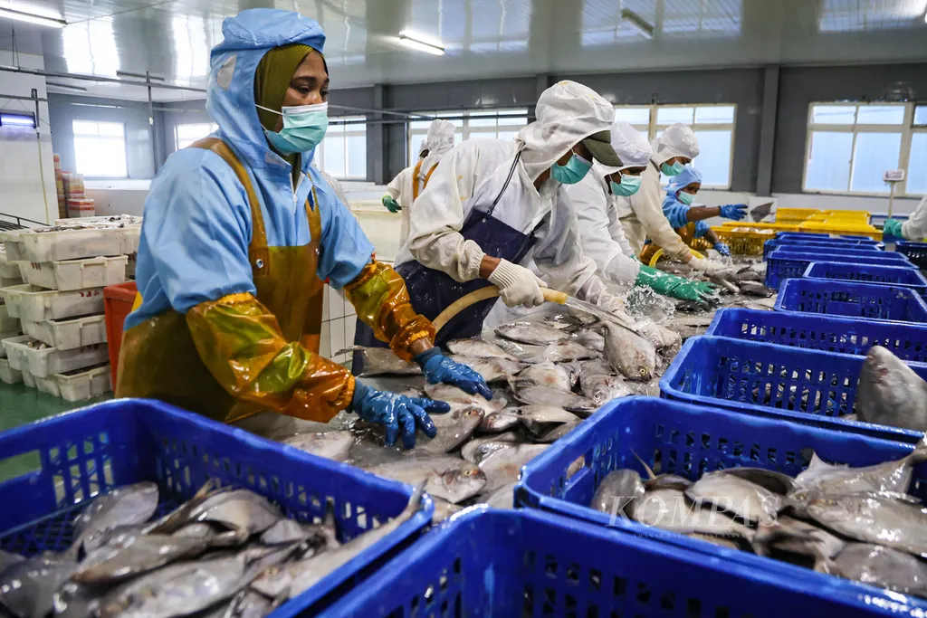
Fisheries Data Collection Aligned with GSBPM by the Ministry of Marine Affairs and Fisheries
GSBPM (Generic Statistical Business Process Model)
Fisheries Data Collection is carried out by the Ministry of Maritime Affairs and Fisheries and Local Governments with different methods for the type of business sector.
Data collecting is conducted with hierarchical validation from the District/City level to the Provincial and National levels.
to harmonize terminology and processes across statistical organizations, improve quality, facilitate process documentation, and support integration of data and metadata standards
Validated data should be based on aggregated data at the district/city level.
Ensure aggregated data sufficiently represents the actual conditions.
Data adjustments may still be required based on population area and sample size.
Validated data must be nationally agreed upon, with no discrepancies between central and regional data.
Incomplete data, missing data, or limited fish type data should be filled using previous year’s data or other reliable sources.
Capture Fisheries
1
Specify Needs
Identify and confirm statistical requirements and objectives
Divided by Fish Port & Non-Fish Port
665 Data Collectors
Develop methodology, collection instruments, and processing plans
2
Design
3
Create or adapt systems and tools for data collection and processing
Build
Aquaculture Fisheries
Gather data using designed instruments and methods
4
Collect
Covers seawater aquaculture, brackish water aquaculture, and freshwater aquaculture.
4.428 Enumerators
5
Validate, edit, integrate, and aggregate collected data
Process
Interpret data and prepare outputs
6
Fish Processing Unit
Analyze
7
Publish and distribute statistical products
Disseminate
34 Provinces, 382 Cities
109.299 Samples
688 Data Collectors
Assess the process and outputs for quality improvement
8
Evaluate
https://unstats.un.org/unsd/nationalaccount/workshops/2015/gabon/bd/GSBPM-ENG.pdf
Ministry of Maritime Affairs and Fisheries , 2025
Notes:
https://www.youtube.com/watch?v=yIvyZOm2G6A

Slide 7
Thank You

Slide 8
Term of Reference
small-scale marine fisheries face complex and dynamic issues including
ecosystem health,
social justice,
livelihood, and
food security.
1. Technical fisheries data from small-scale marine fisheries
2. commercial fisheries data
is an essential scientific database to
assess the status of fishery resources,
providing a more accurate assessment
leading to appropriate fishery management measures establishment for sustainable fisheries among AMS
sustainable fisheries management which will
enhance the contribution of fisheries to food security
better livelihood of the peoples of the region.
the project’s objectives are:
To improve data collection and records of small-scale marine fisheries for sustainable fisheries management;
To serve as a forum for AMS to identify and exchange best practices, lessons learned and experiences in small-scale marine fisheries data collection and analysis as a tool to promote sustainable fisheries in the region; and
To strengthen networking and close coordination of fishery sector among AMS.

Slide 9
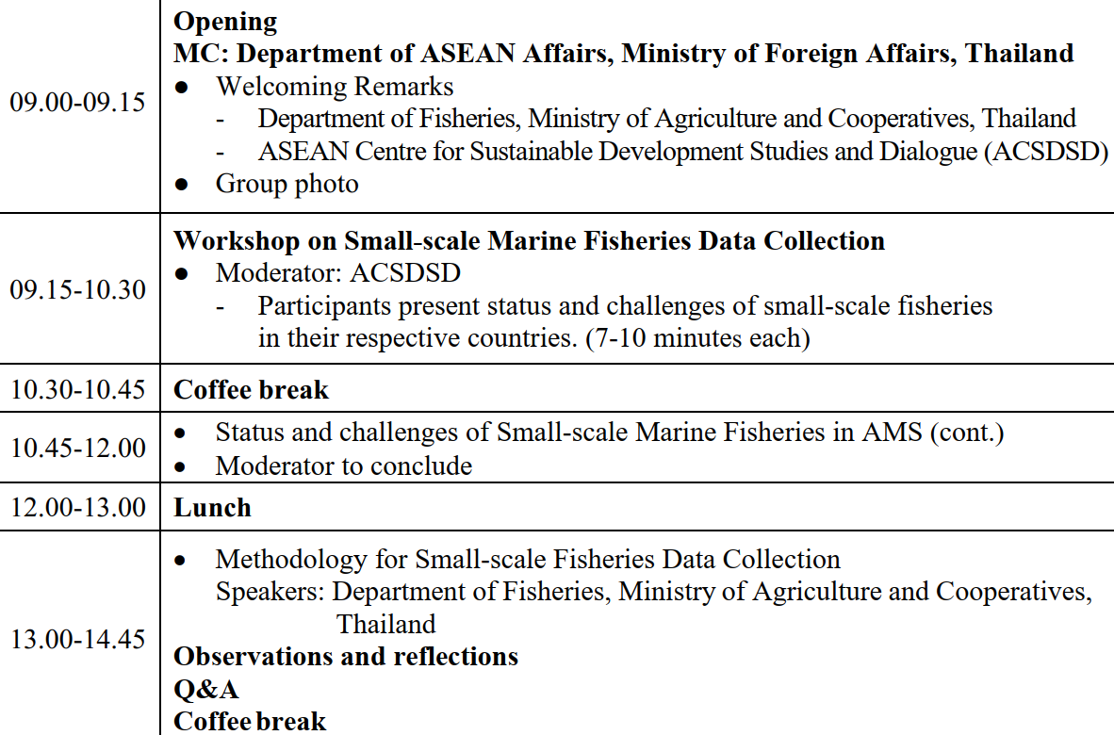

Slide 10
Specify Needs: Identify and confirm statistical requirements and objectives.
Design: Develop methodology, collection instruments, and processing plans.
Build: Create or adapt systems and tools for data collection and processing.
Collect: Gather data using designed instruments and methods.
Process: Validate, edit, integrate, and aggregate collected data.
Analyze: Interpret data and prepare outputs.
Disseminate: Publish and distribute statistical products.
Evaluate: Assess the process and outputs for quality improvement.

Slide 11
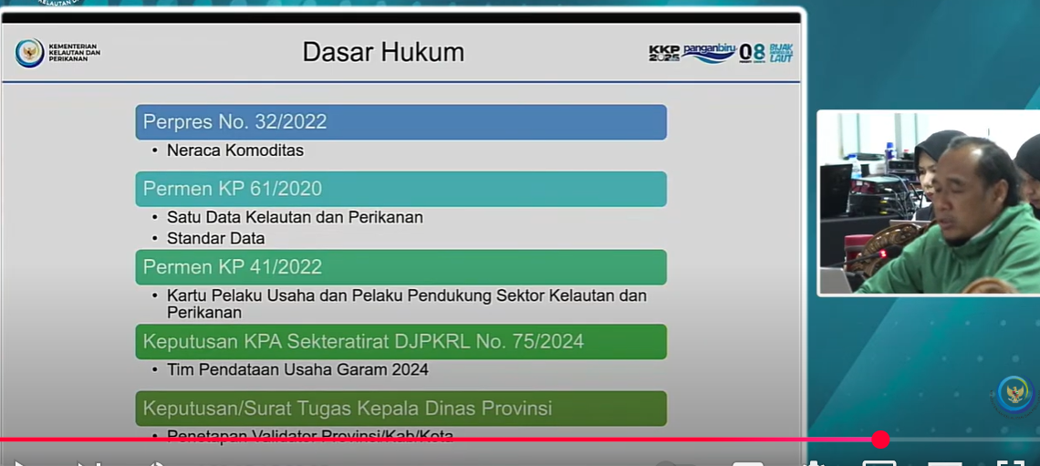

Slide 12
Peningkatan Kapasitas UPI
https://www.liputan6.com/bisnis/read/5884892/kkp-90-dari-477-juta-pelaku-usaha-sektor-kelautan-dan-perikanan-adalah-umkm?page=3
https://www.kkp.go.id/news/news-detail/kkp-optimalkan-dak-untuk-bedah-upi-skala-mikro-sokong-swasembada-pangan-83Mm.html
https://validnews.id/ekonomi/kkp-dorong-produk-umkm-perikanan-masuki-pasar-ekspor

Slide 13
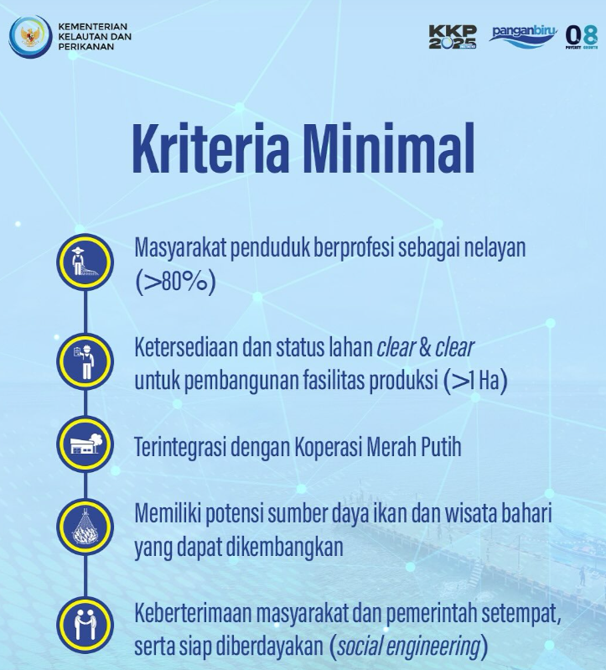
KMNP
https://kkp.go.id/news/news-detail/kkp-buktikan-konsep-kampung-nelayan-merah-putih-berkelanjutan-Y7RA.html
https://kkp.go.id/news/news-detail/kkp-segera-bangun-100-kampung-nelayan-merah-putih-di-2025-ayo-daftar-sekarang-A67j.html
https://www.antaranews.com/berita/4902201/kkp-pastikan-program-kampung-nelayan-merah-putih-akan-berjalan
https://www.tempo.co/ekonomi/fitra-kritik-program-kampung-nelayan-merah-putih-1652990

Slide 14
Upaya pemerintah dalam mengelola perikanan skala kecil Berbasis kearifan lokal
Dukungan untuk Nelayan Skala Kecil Direktorat Jenderal Perikanan Tangkap mempromosikan pendekatan Indonesia dalam mengelola perikanan skala kecil, menekankan kearifan lokal, perlindungan daerah penangkapan ikan, dan inovasi seperti sertifikasi berbasis masyarakat melalui "label sasi" [01:30:51]. Mereka juga menganjurkan reformasi dalam ecolabeling agar lebih inklusif dan relevan bagi negara-negara berkembang [01:31:11].
Kebijakan penangkapan ikan terukur berbasis kuota yang diterapkan di Indonesia terbukti efektif mendorong
pertumbuhan produksi perikanan tangkap nasional sebesar rata-rata 3,94 persen per tahun, dari 4,51 juta ton pada 2016 menjadi 7,71 juta ton pada 2023,
menjadikan Indonesia sebagai negara dengan produksi perikanan tangkap terbesar kedua di dunia setelah China.
kolaborasi Indonesia dengan inisiatif global seperti CFI Indonesia dalam mendukung pengelolaan perikanan skala kecil berbasis masyarakat.
inisiatif Sasi Label di Kepulauan Maluku, yang mengangkat kearifan lokal berupa larangan sementara penangkapan ikan untuk memberi waktu pemulihan sumber daya ikan.
Model ini tidak hanya melindungi ekosistem laut, tetapi juga memperkuat kelembagaan lokal, meningkatkan peran perempuan, serta mendorong akses pasar dan kesejahteraan nelayan melalui koperasi dan teknologi digital seperti e-logbook
Indonesia merupakan negara kepulauan terbesar keempat di dunia, dengan
potensi lestari perikanan tangkap mencapai 12 juta ton dan
keanekaragaman hayati laut yang sangat tinggi
kolaborasi Indonesia dengan inisiatif global seperti CFI Indonesia dalam mendukung pengelolaan perikanan skala kecil berbasis masyarakat.

Slide 15
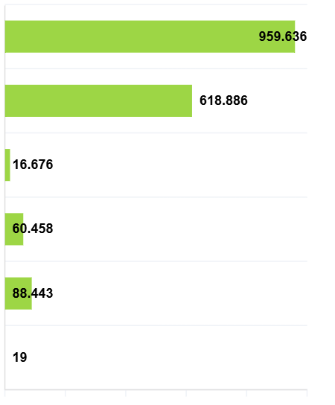
KUSUKA
Card for Marine and Fisheries Business Actors (KUSUKA)
Official identity for business actors in the marine fisheries sector as a national database and makes it easier for business actors to access government programs.
https://diskan.serangkab.go.id/page/kusuka-kartu-pelaku-usaha-kelautan-dan-perikanan
https://dkpp.bulelengkab.go.id/informasi/detail/artikel/52_mengenal-kusuka-kartu-pelaku-usaha-kelautan-dan-perikanan
Marine Capture Fisheries
Aquaculture
Marine Space Utilization
Fish Trading
Fish Manufacturing
Fish Transportation and Distribution
Notes:
Identitas resmi bagi pelaku usaha di sektor kelautan perikanan sebagai basis data nasional dan memudahkan pelaku usaha mengakses program pemerintah

Slide 16
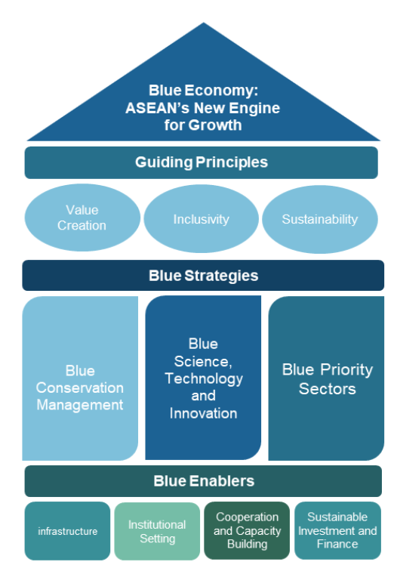
Small-scale fisheries management have become one of the major concerns to be addressed in the ASEAN Blue Economy Framework
ASEAN Blue Economy Framework
ensuring that all stakeholders, including small-scale fishers, have access to the benefits of sustainable ocean and inland water resource utilisation²
build social cohesion
foster sustainable development
improve the overall resilience of local and coastal communities¹
engaging and including stakeholders in decision-making processes
¹particularly when good regulatory practices are applied
²including businesses, like micro, small and medium enterprises (MSMEs), small-scale fishers, and local and coastal communities
Notes:
– including businesses, like micro, small and medium enterprises (MSMEs), small-scale fishers, and local and coastal communities –

Slide 17
Overfishing, Illegal, Unreported and Unregulated Fishing
Indonesia is ranked 6th lowest out of 152 countries in dealing with IUU Fishing, with a score of
2.89
destruction of local fisheries, and small-scale fisheries that are particularly vulnerable
Threaten livelihoods, worsen poverty, and raise food insecurity.
Degradation of the Marine Environment
use of destructive fishing gear, mangrove deforestation,
Climate Change
Increase in seawater temperature, ocean acidification, and sea level rise
Marine Pollution
53 million metric tons of plastic waste will pollute global aquatic ecosystems by 2030
Reducing marine fish stocks could lead to a 35% drop in fisheries production.
Extreme weather has left coastal communities homeless and fisherman struggling to catch fish
UNEP, 2018

Slide 18
lautan Indonesia merupakan wilayah Marine Mega Biodiversity terbesar di dunia dengan 950 spesies biota terumbu karang dan ribuan spesies laut lainnya
Untuk perikanan, Laut Indonesia memiliki Sumber Daya Ikan (SDI) meliputi 37 persen dari spesies ikan di dunia, di mana beberapa jenis diantaranya mempunyai nilai ekonomis tinggi, seperti tuna, udang, lobster, ikan karang, beberapa jenis ikan hias, kekerangan, dan rumput laut (Kementerian Koordinator Bidang Kemaritiman dan Investasi Republik Indonesia, 2020)

Slide 19
total estimasi potensi sumber daya ikan di 11 WPPNRI mencapai 12,01 juta ton per tahun, dengan JTB sebesar 8,6 juta ton per tahun. Potensi tersebut terbagi dalam sembilan kelompok sumber daya ikan, yaitu ikan demersal, ikan karang, pelagis kecil, cumi-cumi, udang penaeid, lobster, rajungan, kepiting, dan pelagis besar.
Keputusan Menteri Kelautan dan Perikanan Republik Indonesia Nomor 19 Tahun 2022

Slide 20
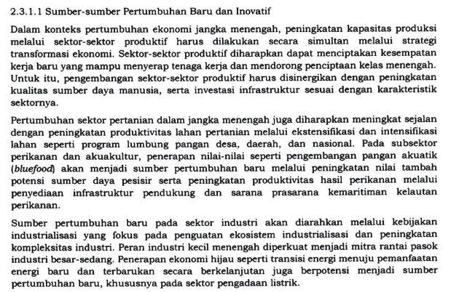
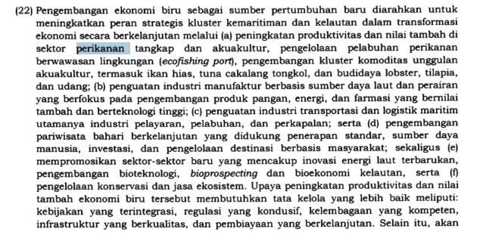
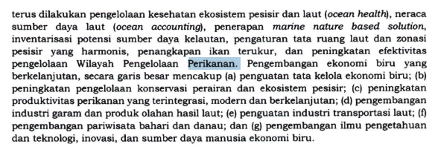
RPJMN
Pengembangan pangan akuatik (Bluefood)
Peningkatan nilai tambah potensi sumber daya pesisir
Peningkatan produktivitas hasil, perikanan
penyediaan infrastruktur pendukung dan sarana prasarana kemaritiman kelautan perikanan
Peningkatan produktivitas dan nilai tambah di sektor perikanan tangkap dan akuakultur
Pengelolaan Pelabuhan perikanan berwawasan lingkungan (ecofishing port)
Pengembangan kluster komoditas unggulan akuakultur termasuk ikan hias, TCT, dan budidaya lobster, tilapia dan udang
Penguatan industry manufaktur berbasis SDA laut dan perairan yang berfokus pada pengembangan produk pangan energi dan farmasi yang bernilai tambah dan berteknologi tinggi
Penguatan industry transportasi dan logistik maritim utamanya industry pelayaran, Pelabuhan dan perkapalan
Pengembangan pariwisata Bahari berkelanjutan yang didukung penerapan standar, SDM, investasi, dan pengelolaan destinasi Berbasis Masyarakat
Mempromosikan sektor-sektor baru yang mencakup energi laut terbarukan, pengembangan bioteknologi, bioprospecting dan bioekonomi kelautan
Pengelolaan konservasi dan jasa ekosistem
Tata Kelola yang baik :
Kebijakan yang terintegrasi
Regulasi yang kondusif
Kelembagaan yang kompeten
Infrastruktur yang berkualitas
Pembiayaan yang berkelanjutan
Pengelolaan Kesehatan ekosistem pesisir dan laut (ocean health)
Neraca sumber daya laut (ocean accounting)
Penerapan marine nature-based solution
Inventarisasi potensi sumber daya kelautan
Pengaturan tata ruang laut dan zonasi pesisir yang harmonis
Penangkapan ikan terukur
Peningkatan efektifitas pengelolaan wilayah pengelolaan perikanan
Pengembangan ekonomi biru yang berkelanjutan:
Penguatan tata Kelola ekonomi biru
Peningkatan pengelolaan konservasi perairan dan ekosistem pesisir
Penignkatan produktivitas perikanan yang terintegrasi , modern, dan berkelanjutan
Pengembangan industry garam dan produk olahan hasil laut
Penguatan industry transportasi laut
Pengembangan pariwisata Bahari dan danau
Pengembangan ilmu pengetahun dan teknologi, inovasi, dan sumber daya manusia ekonomi biru

Slide 21
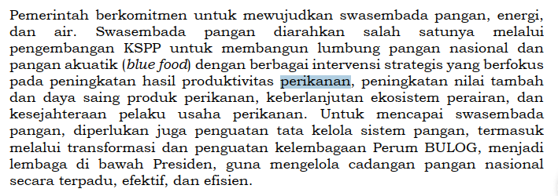
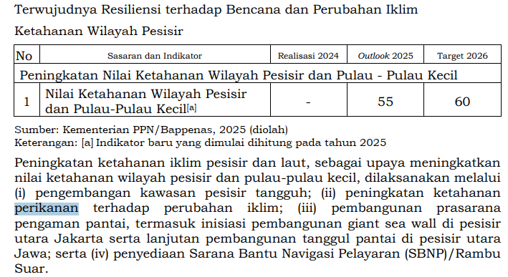
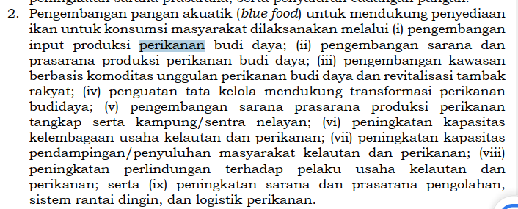
Pengembangan pangan akuatik (Bluefood)
Peningkatan hasil produktivitas perikanan
Peningkatan nilai tabah dan daya saing produk perikanan
Keberlanjutan ekosistem perairan dan kesejahteraan pelaku usaha perikanan
Pengembangan pangan akuatik (Bluefood)
Pengembangan input produksi perikanan budi daya.
Pengembangan sarana dan prasarana produksi perikanan budi daya.
Pengembangan kawasan berbasis komoditas unggulan perikanan budi daya dan revitalisasi tambak rakyat.
Penguatan tata kelola mendukung transformasi perikanan budidaya.
Pengembangan sarana prasarana produksi perikanan tangkap serta kampung/sentra nelayan.
Peningkatan kapasitas kelembagaan usaha kelautan dan perikanan.
Peningkatan kapasitas pendampingan/penyuluhan masyarakat kelautan dan perikanan.
Peningkatan perlindungan terhadap pelaku usaha kelautan dan perikanan.
Peningkatan sarana dan prasarana pengolahan, sistem rantai dingin, dan logistik perikanan.
Ekonomi Biru
Penguatan tata Kelola ekonomi biru
Pengingkatan pengelolaan konservasi perairan dan ekosistem pesisir
Peningkatan produktivitas perikanan yang terintegrasi modedn dan berkelanjutan
Pengembangan industry garam dan produk olahan hasil laut
Penguatan industry transportasi laut
Pengembangan pariwisata Berbasis Bahari dan danau
Pengembangan iptek inovasi dan SDM ekonomi biru

Slide 22
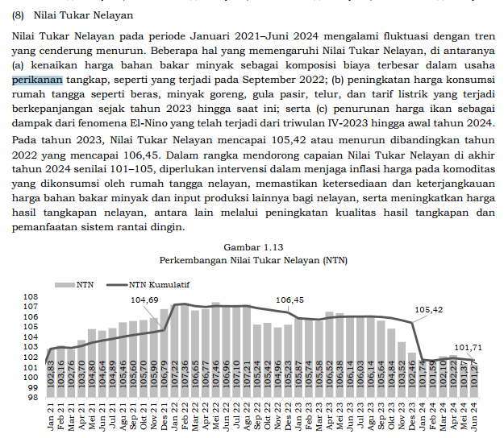
Nilai Tukar Nelayan

Slide 23
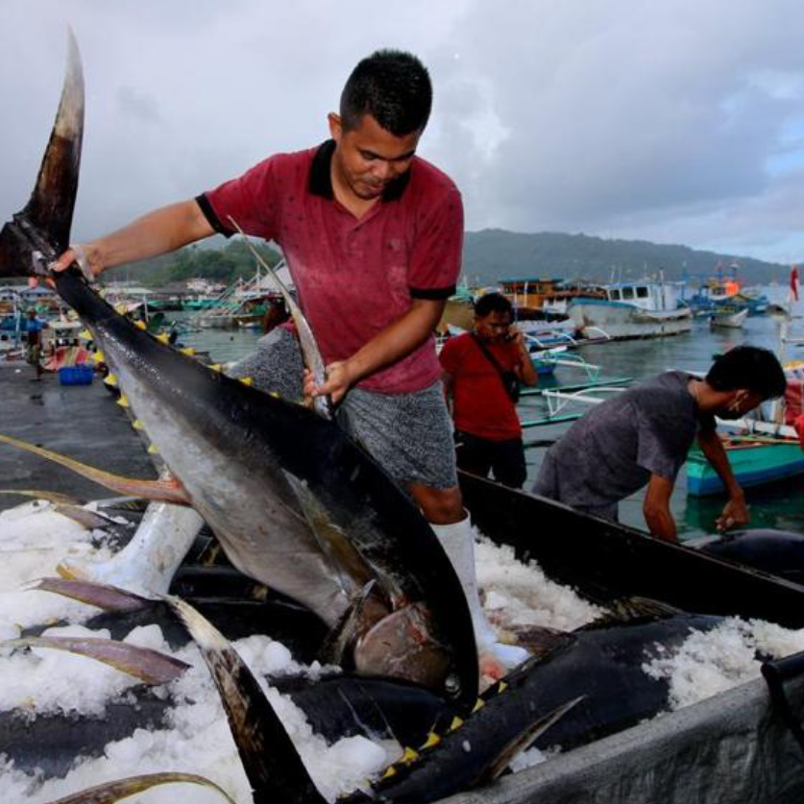
Issues and challenges faced by Indonesia's fisheries sector
2,1^{mio}
90%
1st
people living in coastal areas are involved in small-scale fisheries, they rarely exceeds the national poverty line substantively
of Marine and Fisheries Sector Business Actors in Indonesia are MSMEs
Marine capture fisheries and aquaculture are the largest sectors in Indonesia's Blue Economy
The issues and challenges in Marine capture fisheries and aquaculture
overstock and overfishing
unsustainable practices,
including the replacement of mangrove and sea grass areas into aquaculture
lack of governance in marine resources management to deal with IUUF
stagnated productivity due to welfare and working conditions problems
pollution and ecosystem degradation
Notes:
90% dari 4,77 Juta Pelaku Usaha Sektor Kelautan dan Perikanan Adalah UMKM

Slide 24
The direction of marine capture fisheries and aquaculture development
Improve productivity, enhance the value added and the sustainable practices
Promoting the implementation of sustainable management of fisheries and aquaculture activities
implementing marine capture fisheries-based quota, ecosystem approach and better harvest strategy
improving aquaculture practices into more sustainable and nature positive including improved regulation on aquaculture zoning, and applying
sustainable technology solutions, robust standards and certification schemes as well as providing incentive schemes for sustainable practices; standards
boosting the downstream of marine capture fisheries and aquaculture products supported by the development of a resilient supply chain involving the partnership between small-scale fishers and medium-large industries, and the application of innovative and sustainable technology solutions
providing training including on good practices in fish handling and aquaculture in order to improve the quality of fishery products, and monitoring to reduce IUUF practices
improving marine capture fisheries and aquaculture technology, research and data
improving productivity supported by a social protection scheme for fishers and maritime workers, and better access to finance for small scale actors
promoting effective policies and program related to the implementation of marine debris and food-loss control management to maintain a healthy marine ecosystem for sustainable fisheries

Slide 25
Update on Issues and Challenges of small-scale fisheries in Indonesia
90% dari 4,77 Juta Pelaku Usaha Sektor Kelautan dan Perikanan Adalah UMKM
Marine capture fisheries and aquaculture are the largest sectors in Indonesia's Blue Economy in their contribution to the economy and as a source of national and global food providers.
Marine capture fisheries and aquaculture also have a role in creating jobs and employment opportunities.
The positive and significant impact of marine capture fisheries and aquacultures in Indonesia’s economy occurs due to the high demand for marine capture fishery and aquaculture products in the market, which leads to an increase in marine capture fisheries and aquaculture volume
In the fishery sector in Indonesia, the character is dominated by a combination of subsistence and small-scale commercial fisheries. The Ministry of Marine Affairs and Fisheries noted that 2.1 million people living in coastal areas are involved in small-scale fisheries32. Nevertheless, although small-scale fisheries are the epicentre of dynamic economic activity, they have not yet brought prosperity for the community. The income of fish workers (fishers, processors, and traders) could exceed the average wage of rural labour but rarely exceeds the national poverty line substantively, except where fish workers have fishing gear and boats.
To improve the livelihood of coastal communities, stakeholders, including the government, need to support to improve small-scale fisheries governance. This can be implemented through better provision of data and information in the fishery sector. The data can include local wisdom that has been adopted by the community and formalised by positive law. Based on the data, the local government can propose the protection of local marine and coastal areas, and this correspond to the Law No. 27 year 2007 jo. No. 1 year 2014 on the Management of Coastal Zone and Small Islands, which mandates the protection of indigenous people in coastal and small islands. The approach to sustainable utilization of fishery resources through a fisheries open and close system that is integrated with customary law and positive law not only supports fisheries activities but also in terms of ecosystem protection
the issues and challenges such as
overstock and overfishing;
unsustainable practices, including the replacement of mangrove and sea grass areas into aquaculture;
lack of governance in marine resources management to deal with IUUF;
stagnated productivity due to welfare and working conditions problems; and
pollution and ecosystem degradation.
Indonesia Blue Economy Roadmap

Slide 26
Policy Direction of Indonesia Blue Economy
In order to improve productivity, enhance the value added and the sustainable practices of this sector
The direction of marine capture fisheries and aquaculture development will focus on promoting the implementation of sustainable management of fisheries and aquaculture activities, including
implementing marine capture fisheries-based quota, ecosystem approach and better harvest strategy;
improving aquaculture practices into more sustainable and nature positive including improved regulation on aquaculture zoning, and applying
sustainable technology solutions, robust standards and certification schemes as well as providing incentive schemes for sustainable practices; standards;
boosting the downstream of marine capture fisheries and aquaculture products supported by the development of a resilient supply chain involving the partnership between small-scale fishers and medium-large industries, and the application of innovative and sustainable technology solutions;
providing training including on good practices in fish handling and aquaculture in order to improve the quality of fishery products, and monitoring to reduce IUUF practices;
improving productivity supported by a social protection scheme for fishers and maritime workers, and better access to finance for small scale actors;
improving marine capture fisheries and aquaculture technology, research and data; and
promoting effective policies and program related to the implementation of marine debris and food-loss control management to maintain a healthy marine ecosystem for sustainable fisheries
Notes:
Arah kebijakan blue economy indonesia

Slide 27
To ensure the inclusiveness of blue economy development in Indonesia, particularly in priority sectors, this Blue Economy Roadmap recognizes the livelihoods of the people involved in the supply chain of the eight priority sectors.
The implementation of this Blue Economy Roadmap encourages the application of livelihood strategies by considering different activities and roles of different actors in contributing to the supply chain of the priority sectors.
Such strategies are expected to improve people’s understanding about their modalities and resources, socio-economic opportunities available, options to enable higher resilience against risks including disasters, and their potential contribution to better environmental planning and management.
The employment structure on these sectors is complex. The Food and Agriculture Organization (FAO) has assessed that the global employment in fisheries and aquaculture covers a complex and large range of jobs. It can include from the input production and sales (vessels, fishing gear, bait, etc) to fish farming, harvesting, post-harvesting, processing, marketing and distribution of fish/products. This condition also attracts many parts of people living in the coastal areas and the surroundings to get involved in the fisheries and aquaculture.
The condition also accommodates from labor intensive small-scale business operations to capital and labor intensive large investment-based businesses

Slide 28
Salah satu upaya pemerintah meningkatkan kapasitas UMKM Perikanan
berdasarkan data Pusdatin KKP tahun 2024, pelaku usaha skala mikro dan kecil di bidang pengolahan hasil perikanan berjumlah 76.318 unit. Dari jumlah tersebut, 35,5% di antaranya terkonsentrasi di Pulau Jawa.
Budi menjabarkan usaha pengeringan ikan menjadi salah satu usaha yang banyak digeluti oleh pelaku UMKM dengan jumlah UPI sebanyak 17.033 unit atau 22,3%, disusul dengan usaha pengolahan berbasis lumatan ikan (surimi) sebanyak 18,1%, serta usaha pemindangan ikan sebanyak 9,9%.
Direktur Pengolahan Ditjen PDSPKP, Widya Rusyanto menyebut KKP telah melaksanakan bedah 224 UPI skala mikro kecil selama tahun 2024. Kegiatan tersebut bagian dari pendampingan pelaksanaan DAK yang tersebar di 97 kabupaten/kota serta rehabilitasi bangunan dan pengadaan/perbaikan peralatan di sentra pengolahan yang tersebar di 12 kabupaten/kota di seluruh Indonesia.
Widya mengatakan output dari pendampingan pelaksanaan DAK bedah UPI dan rehabilitasi sentra ini di antaranya agar mereka bisa memperoleh sertifikat kelayakan pengolahan/Good Manufacturing Practices (SKP/GMP) mengingat bangunan UPI yang direhabilitasi telah memenuhi standar jaminan mutu dan keamanan pangan.
"KKP melakukan pendampingan mulai dari perencanaan, desain atau layout ruang produksi dan peralatan pengolahan yang sesuai standar kelayakan pengolahan, hingga monitoring dan evaluasi,” kata Widya.
Widya berharap, melalui program ini, UPI mampu memperluas akses pasar baik di tingkat lokal, nasional, maupun internasional. "Melalui program DAK ini, pemerintah menargetkan UMKM dapat naik kelas, bahkan bisa go internasional," tutupnya.
Sebelumnya, Menteri Kelautan dan Perikanan Sakti Wahyu Trenggono menekankan pentingnya jaminan mutu dan kualitas produk perikanan yang dihasilkan oleh UPI di Indonesia. Menurutnya, jaminan mutu dibutuhkan untuk menambah nilai dan daya saing produk perikanan di pasar domestik maupun global.
mutu dan kualitas produk menjadi salah satu tantangan yang dihadapi UPI mikro dan kecil. Alhasil, mereka kerap kesulitan mengembangkan usahanya, mengingat cara penanganan dan pengolahan yang masih tradisional atau sederhana. "Ruang produksi yang masih menyatu dengan dapur rumah tangga menjadi tantangan tersendiri dalam menghasilkan produk perikanan yang memenuhi jaminan mutu dan kemanan pangan,“
Karenanya, sebagai bentuk dukungan sekaligus meningkatkan kapasitas dan daya saing UMKM di bidang pengolahan hasil perikanan, Ditjen PDSPKP melakukan pendampingan pelaksanaan DAK yang disalurkan melalui Bappenas untuk kegiatan bedah UPI skala mikro dan kecil serta rehabilitasi bangunan dan pengadaan/perbaikan peralatan di sentra pengolahan.
"KKP hadir untuk memberikan penguatan melalui perbaikan ruang produksi, sehingga produk yang dihasilkan UMKM terjamin mutu dan keamanannya," tuturnya.
Budi menjabarkan bedah UPI ditujukan agar UMKM bisa meningkatkan jaminan mutu keamanan hasil perikanan dan meningkatkan produktivitas produksi olahan. Sementara rehabilitasi sentra produksi merupakan kegiatan perbaikan bangunan dan pemberian bantuan peralatan pengolahan kepada sentra pengolahan hasil perikanan yang disesuaikan dengan jenis produk olahan yang dihasilkan.
Tambahan: https://validnews.id/ekonomi/kkp-dorong-produk-umkm-perikanan-masuki-pasar-ekspor

