Slide 1
Status and Challenges of Small-Scale Fisheries in Malaysia
Workshop and Study Visit on Small-scale Marine Fisheries Data Collection
15-17 JULY 2025
BANGKOK, THAILAND
BAHRINAH BINTI BAHRIM
DEPARTMENT OF FISHERIES
MALAYSIA

Slide 2
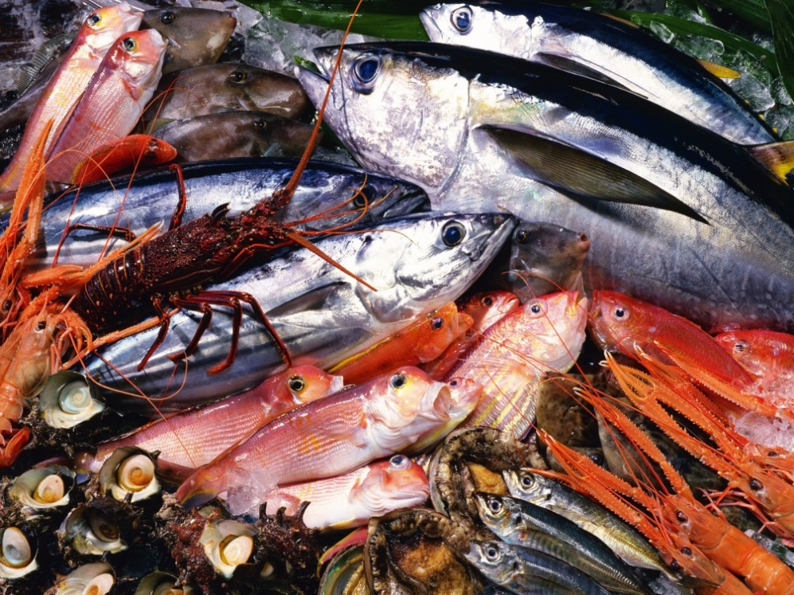
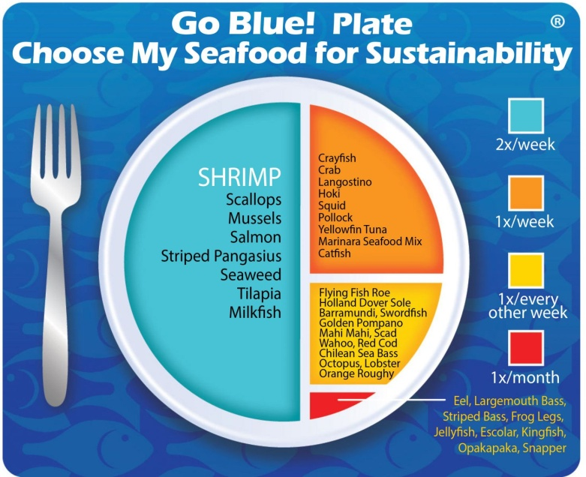
CONTENT
INTRODUCTION
CAPTURED FISHERIES PROFILE
GENERAL LICENSING PROVISIONAL
MANAGEMENT INSTRUMENTS
MANAGEMENT MEASURES
MONITORING, CONTROL, AND SURVEILLANCE (MCS)
CHALLENGES & ISSUES
CONCLUSION

Slide 3
INTRODUCTION

Slide 4
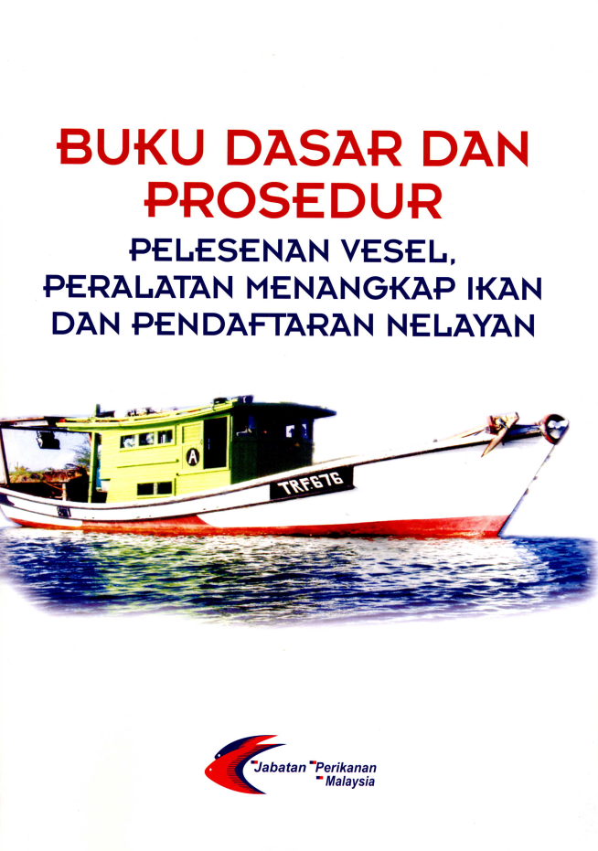
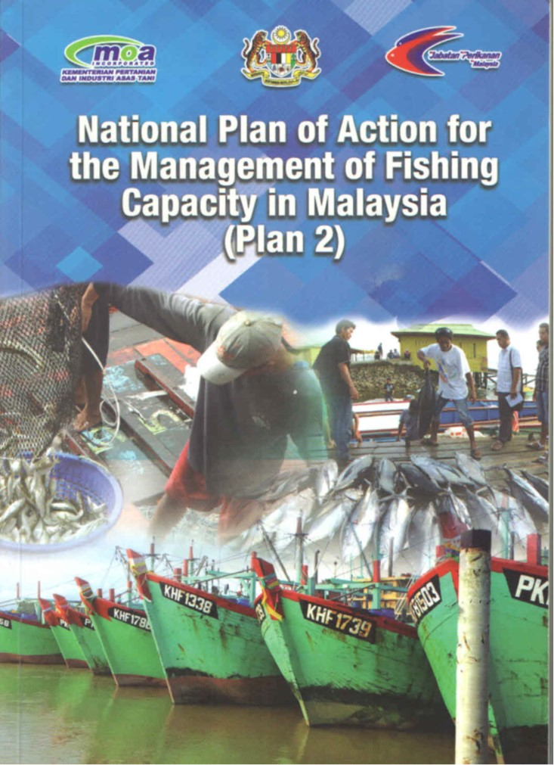
GOVERNANCE, POLICIES AND PROCEDURES FOR FISHERIES MANAGEMENT
INTRODUCTION

Slide 5
Malaysian Fisheries Waters
INTRODUCTION

Slide 6
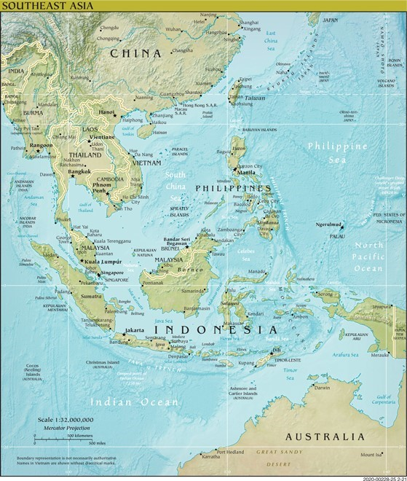
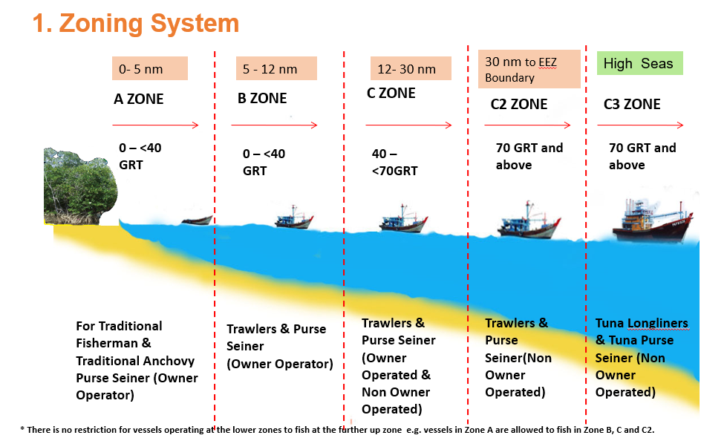
SMALL –SCALE FISHING ZONING AREA
Coastlines – 4,490 km
Extension of Malaysian fisheries waters from 47,9000 sq. nm to 160,000 sq. nm after EEZ declaration in 1980
4,53,186 km² EEZ waters comprises part of the Andaman Sea, the Straits of Malacca, the South China Sea, the Sulu Sea and the Celebes Sea

Slide 7
CAPTURE FISHERIES PROFILE

Slide 8
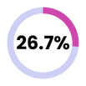
FISHERIES PROFILE 2024
1,913,644 m.t
RM 16.95 bilion*
1,786,587 m.t
RM 16.54 bilion*
Capture Fisheries
1,392,130 m.t
1,270,277 m.t
RM 11.8 bilion
RM 11.4 bilion
Aquakultur
511,860 m.t
506,867 m.t
RM 4.53 bilion
RM 4.47 bilion
Ornamental Fish
209 mil fish
241 mil fish
RM 315 mil
RM 373 mil
Aquatic Plant
21 mil
26 mil
RM 73 mil
RM 85 mil
Inland Fisheries
9,652 m.t
9,434 m.t
RM 190.7 mil
RM 179.7 mil
105,287
12,596
112,344
16,873
24,714
11,455
# fishers
21,545
26,118
# Inland Fishers
43,012
# FARMERS*
Area (Ha)*
49,173
Petunjuk:
Data 2024
Data 2023
# Vessel
6
*included ornamental fish and aquatic plants
Notes:
IKAN HIASA BAKAL TURUN LAGI TAHUN 2025 SEBAB PENURUNAN HARGA PASARAN
ANALISIS AROWANA DARI SEGI HARGA, PENGELUARAN, IMPORT EKSPORT
tambAH PAGE BARU: DATA JANTINA, SYKT/INDIVIDU

Slide 9
Legend:
Data 2024
Data 2023
Capture Fisheries Profile, 2024
Metrik Tan
Landing Trend
2020-2024
# Local Fishers**
Vessel*
Zon A
(0 - 5 b.n)
431,197
61,118
24,008
428,626
68,054
24,791
Zon B
(5 - 12 b.n)
277,658
11,040
1,891
288,287
10,871
2,285
Zon C
(12 - 30 b.n)
472,677
8,918
2,771
384,851
6,965
2,915
Zon C2
(30 b.n - 200 b.n)
210,166
1,386
789
168,334
1,310
712
Zon C3
(International water)
431
2
16
177
17
17
1,392,130
82,464
29,475 unit
1,270,277
87,217
30,720 unit
10
*Not Included Sabah **Not included non-local fishers

Slide 10
SMALL-SCALE CAPTURE FISHERIES 2022
Year | Quantity (MT)
2023 | 716,913
2024 | 708,855
SMALL-SCALE
COASTAL
-1.12%
Declined in quantity
51 %
ZON
A,B
In 2024, there is a -1.12% decline in quantity
COASTAL , DEEP SEA & HIGH SEA
49 %
ZON
C,C2,C3
Notes:
RUJUK JADUAL PENDARATAN
Penurunan pendaratan tahun 2019 berbanding 2018 bagi perikanan laut pantai & juga laut dalam :
terutamanya dari negeri pantai timur di Pahang (turun 17.7%), Johor (turun 5-8%), Kelantan (turun 9%), Sarawak (turun 6%)
disebabkan
aktiviti pemutihan terutamanya vesel C2
vesel yang tidak mematuhi keperluan syarat lesen yang menyebabkan tak dapat renew license
pengurangan operasi di laut disebabkan factor cuaca La Nina, kurang modal baiki kerosakan bot
pindah pengkalan keluar ke negeri lain
isu pencerobohan tangkapan asing & tempatan :
Keseluruhan agensi penguatkuasa 1306
OPS Naga 208
Peningkatan pendaratan laut dalam di negeri Penang (peningkatan 630tm ke 2800tm 347%), Perlis (27000tm ke 44000tm 60%, Kedah, Sabah disebabkan :
kekerapan ke laut
pengutipan data yg lebih baik
pematuhan kepada syarat pelesenan

Slide 11
GENERAL LICENSING PROVISIONAL

Slide 12
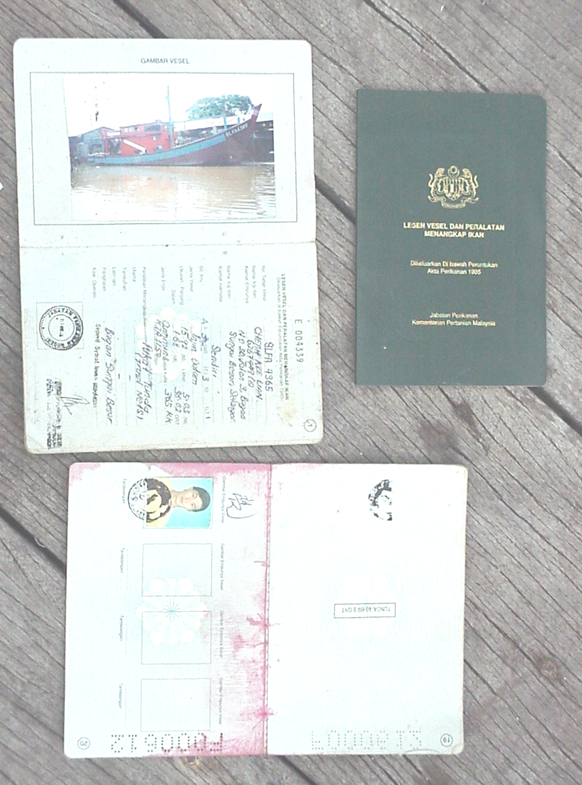
GENERAL LICENSING PROVISIONAL
All fishing activities in Malaysian Waters will need to have a valid license issued by the Department (Sec. 8).
All policies and procedures pertaining to the licensing are based on Fisheries Act 1985 (Part IV) and Vessel Registration Policy and Procedure Handbook
All licensed Fishing Vessels and Fishing Gears have a License Book issued under the Fisheries Act 1985
Licenses issued are subject to resources, categories of vessel and profile of ownership.

Slide 13
MANAGEMENT MEASURES

Slide 14
MANAGEMENT MEASURES
There are specific measures aimed at ensuring a balance among fishing effort, sustainability of resources, environmental conservation and livelihood of the stakeholders. In order to achieve this balance, various conservation and management strategies have been implemented, inter alia, as follows:
i. Regulating the issuance of fishing gear and fishing vessel licences to limit fishing effort;
ii. Restructuring the ownership patterns of fishing licences;
iii. Registration of fishers;
iv. Management of a zoning system based on the tonnage of fishing vessels, type of fishing gears used and ownership patterns;
v. Encourage relocation of fishers to engage in other economic activities such as aquaculture, ecotourism or other related activities;
vi. Conservation and rehabilitation of the marine ecosystems through the establishment of marine protected areas and deployment of artificial reefs;
vii. Continuous research and development, particularly in the monitoring of resource potential and development of resource and eco-friendly fishing gears;.
viii. Prohibition of destructive fishing methods such as using explosives and poisons, pair trawling, moro-ami, beam trawl, electric fishing and mechanized push net; and Imposition of specification for trawl nets, namely:
• Cod-end mesh size not less than 38 millimetres
• Head rope length not exceeding more than 40 meters.

Slide 15
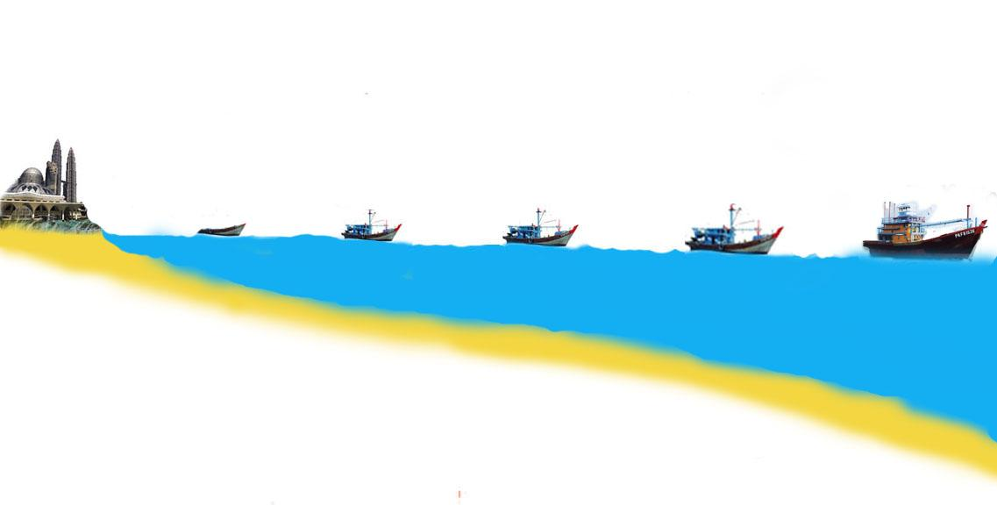
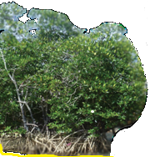
MANAGEMENT MEASURES
1. Zoning System
0- 5 nm
5 - 12 nm
12- 30 nm
30 nm to EEZ Boundary
High Seas (Indian Ocean)
A ZONE
B ZONE
C ZONE
C2 ZONE
C3 ZONE
0 – <40 GRT
0 – <40 GRT
40 – <70GRT
70 GRT and above
70 GRT and above
For Traditional Fisherman & Traditional Anchovy Purse Seiner (Owner Operator)
Trawlers & Purse Seiner
(Owner Operator)
Trawlers & Purse Seiner (Owner Operated & Non Owner Operated)
Tuna Longliners & Tuna Purse Seiner
Trawlers & Purse Seiner

Slide 16
Zone A: < 5 nm from the shore, reserved solely for fishermen operating traditional fishing gears and using fishing vessels of less than 40 gross registered tonnage (GRT) and owner operated;
Zone B: > 5 nm, for owner operated commercial fishing gears such as trawl nets and purse nets, vessels < 40GRT. Zone A operators can also fish in this zone.
Zone C: > 12 nm, for commercial fishing vessels with capacity > 40GRT; Zone A and B operators can fish in this area.
Zone C2: > 30 nm, for deep sea vessels, fishing with vessels of ≥ 70GRT. Zone A, B and C operators can fish in this zone.

Slide 17
MANAGEMENT MEASURES
2. Limiting the Fishing Effort
Issuance of new fishing license for coastal fisheries was halted since 1982 (moratorium) meant to reduce fishing pressure
Vessels registration to control their entry into the fishing industry
Registration of fishermen
Owner-operated for vessels in fishing Zone A and Zone B

Slide 18
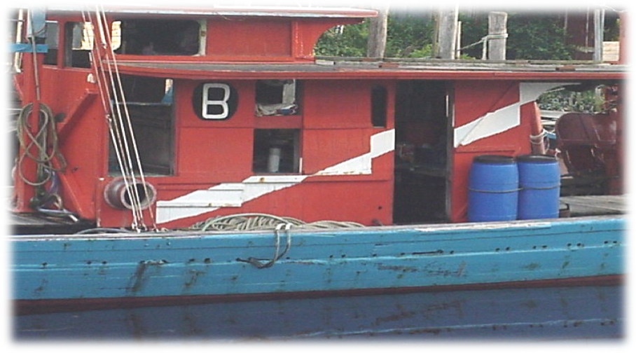
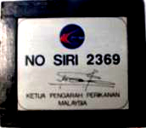
Marking & identification of fishing vessels
Registration Number
Special marking on trawlers
Tin Plate Plate
Wheel House
Fishing Zone marking
License Book

Slide 19
MANAGEMENT MEASURES
3. Conditions of Licensing
not transferable - Trawlers
modify or change vessel hull
Compulsory to install Monitoring Tracking Unit or Automatic Identification System
Compulsory to install MAED
Compulsory to install JTED
Enforce the implementation of the use of mesh size of cord end not less than 38 mm

Slide 20
MANAGEMENT MEASURES
4. PENALTY FOR ENCROACHMENT THE AREA OF 5 NM AND BELOW)
No. Of Offence | GRT of Trawler
 | < 25 GRT | 25 - < 40 GRT | 40 - < 70 GRT | > 70 GRT
1st time | Compound RM3,000 + 1 year license suspension + Fishing gears confiscated + Ownership change is not allowed for 5 years + Proceeds from the auction of fishes forfeited |  | Compound RM6,000 + 1 year license suspension + Fishing gears confiscated + Ownership change is not allowed for 5 years + Proceeds from the auction of fishes forfeited | Compound RM12,000 + 1 year license suspension + Fishing gears confiscated + Ownership change is not allowed for 5 years + Proceeds from the auction of fishes forfeited
2nd time
3rd time | Court

Slide 21
MONITORING, CONTROL, AND SURVEILLANCE (MCS)

Slide 22
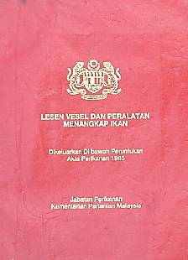
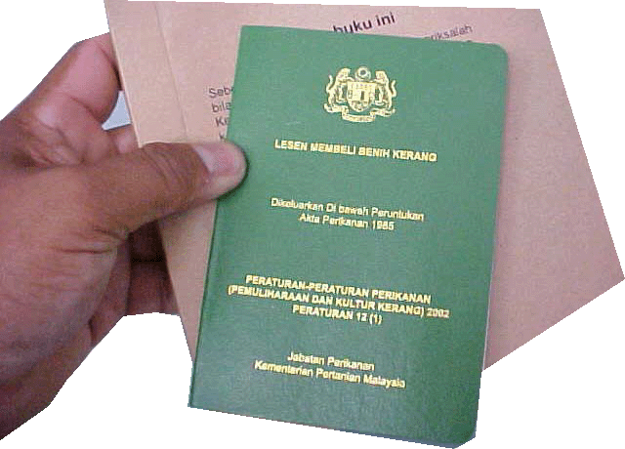
MONITORING, CONTROL, AND SURVEILLANCE (MCS)
Monitoring : collection of information and data on the fishing industry (landings & resource surveys).
Control : the issuance of fishing license is regulated to avoid excessive fishing effort ensuring sustainable fishing.
Surveillance – to enforce Fisheries Act 1985 and its regulations and also in collaboration with other maritime enforcement agencies.

Slide 23
VMS/AIS Monitoring Center
Kelantan
Perak
Putrajaya
Tg. Manis

Slide 24
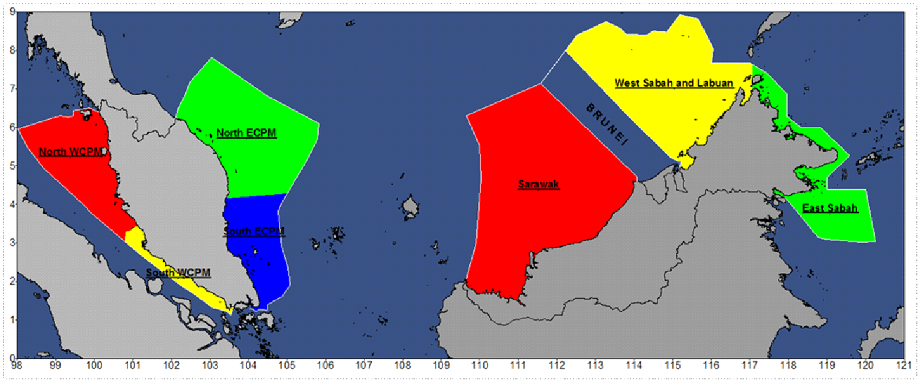
PROPOSED FISHERIES MANAGEMENT AREAS (FMA)
6
3
1
5
7
4
2
North WCPM waters
South WCPM waters
North ECPM waters
South ECPM waters
Sarawak waters
West Sabah and Labuan waters
East Sabah waters

Slide 25
CHALLENGES & ISSUES

Slide 26
CHALLENGES & ISSUES IN SMALL SCALE FISHERIES
IUU Fishing
(Traceability, MCS & Catch Certificate)
Fish Stock assessment
Environmental Degradation (Destructive Fishing practices & Pollution from
Fisheries & Aqua)
Fish Loss (Quantity, Quality & Nutrition)
By-Catch, Discard & Ghost Fishing
Climate Change
(Resilience: Adaptation and mitigation)
Market Measures
(Tariff & Non Tariff, Market Access)

Slide 27
CHALLENGES & ISSUES IN COLLECTING DATA
Limited budget
Too Dispersed landing site
Lack of trust in authorities
Data securities
Languages barries
Too many landing sites
Too many fishers / vessels

Slide 28
CONCLUSION
Aims to create fisheries that are not only economically viable but also profitable and sustainable in the long term while protecting and conserving the environment.
Coastal fisheries will be continuously and properly managed and protected from adverse impacts by anthropogenic pressures in order to ensure supply of sufficient and safe food for the nation and to provide employment.
Since coastal fisheries reached maximum level of exploitation, the government always emphasize on Proper management practices.
A better knowledge about Small-scale Fisheries through the data collection will improve a better management to this sub-sector of fisheries
Promote deep sea fisheries and aquaculture development to increase fish production to cater for the increasing population.

