Slide 1
Workshop on Small-scale Marine Fisheries Data Collection
for Fisheries Management in ASEAN
Status and challenges of Small-scale Marine Fisheries
In Myanmar
Mr. Htet Phyo Aung
Deputy Director
Ms. La Min Htet Htet Aung
Staff Officer
15th July 2025, Bangkok

Slide 2
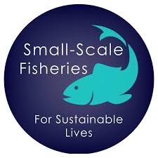
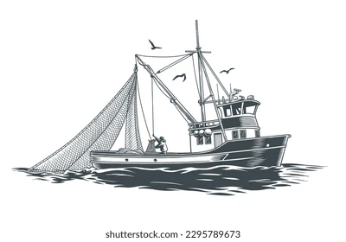
Contents
Introduction
Small Scale Fishing Vessel (Inshore Fishing Vessel)
Stakeholders
Legal Framework
Challenges Faced
Requirements
Opportunities for Improvement
Conclusion

Slide 3
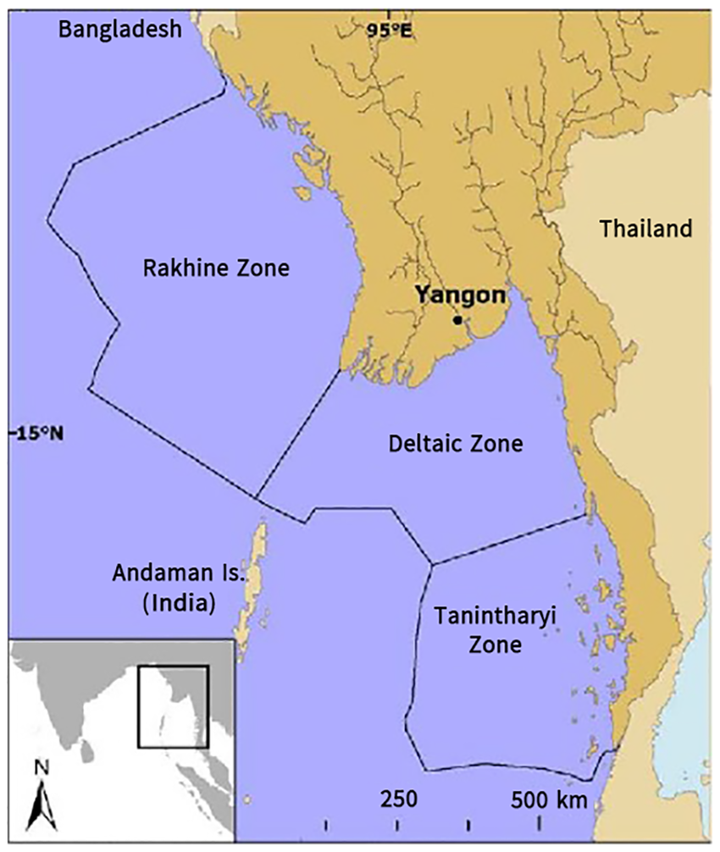
Introduction
Myanmar’s marine fisheries sector is significant due to its long coastline, divided into geographical, resource, and governance zones.
Myanmar has a coastline of approximately 2,832 kilometers, covering: Rakhine Coast, Ayeyarwady Delta Region, Tanintharyi Coast
Marine Fisheries Zones: Inshore Fishing Zone (up to 10 nautical miles/Small Scale) and Offshore Fishing Zone (Beyond 10 nautical miles/Large Scale)
Small-scale fisheries (SSF) in Myanmar are mostly traditional, labor-intensive, and vital for coastal livelihoods.
SSF play a crucial role in Food Supply and Over 3 million people depend on fisheries
These SSF contribute to employment, nutrition, and cultural heritage
Sustainable management is essential to preserve these livelihoods.

Slide 4
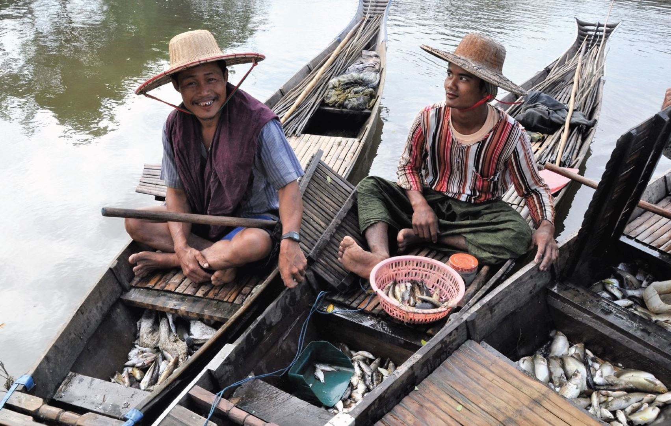
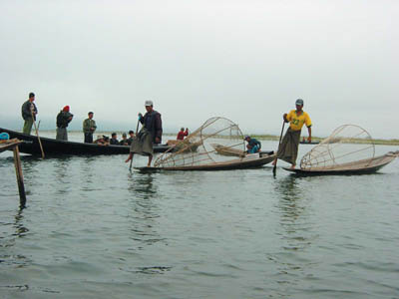
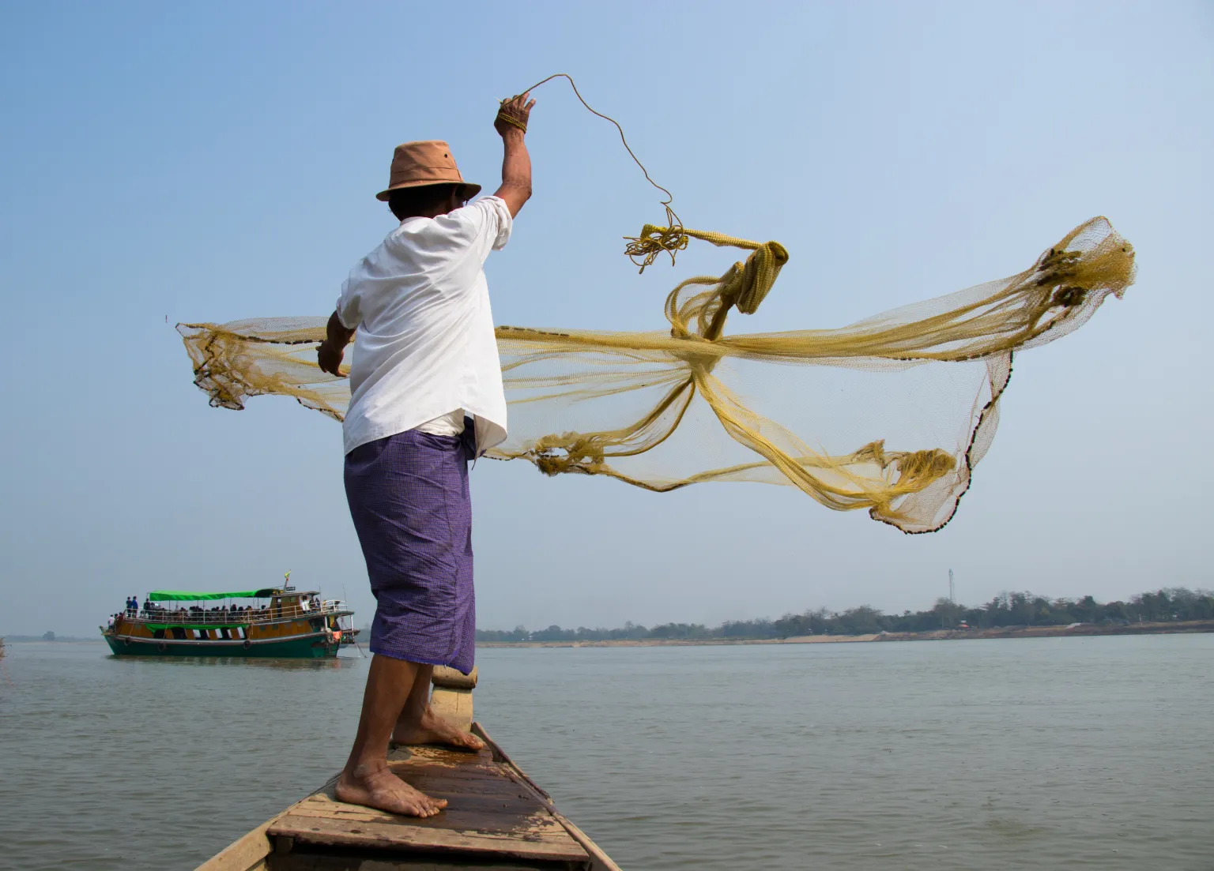
Small Scale Fishing Vessel (Inshore Fishing Vessel)
Inshore fishing vessels in Myanmar are typically small
( Powered Boat 11,239 and Non-Power Boat 3216 (2021-2022 Fishery Statistics 2021)
Wooden-hulled boats, not exceeding 30 feet in length and
Powered by engines under 25 horsepower
Primarily operate within 10 nautical miles of the coastline
Common fishing gear used includes driftnets, gillnets, and longlines

Slide 5
Stakeholders
Local fishermen, communities, and inshore fishing owner association
Managed by Department of Fisheries as primary governance
Relevant Government bodies oversee licensing and conservation efforts
National Coastal Resources Management Committee
Stakeholder collaboration is crucial for sustainable fisheries

Slide 6
Legal Framework
Fisheries law provides guidelines for fishing rights and sustainability
Fishing licenses and gear restrictions are issued by regional departments
Environmental Conservation Law and Rule for sustainable fisheries resources
Environmental Impact Assessment Procedure : In land Fisheries (rivers, lakes)
Total water surface ≥ 1 ha but < 100 ha (IEE) and ≥ 100 ha (EIA)
Co-Management in Rakhine State, cover an area of 179200 acre and extend in Ayeyarwaddy Region
LMMA in in Tanintharyi coastal area (cover 24643 acre in 3 LMMAs for Done Pale Aw village, Langann village and Linn Lon Village)

Slide 7
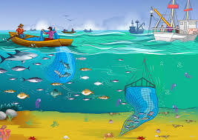
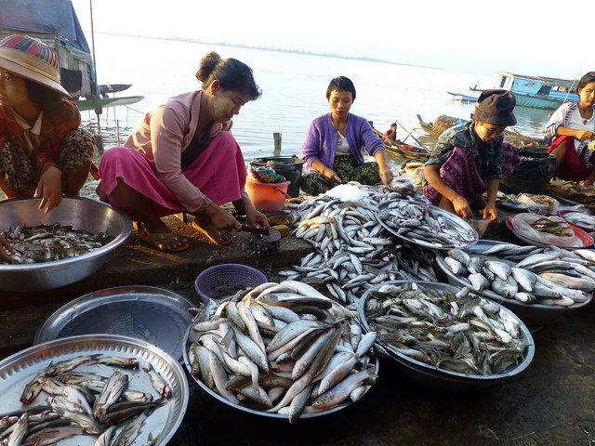
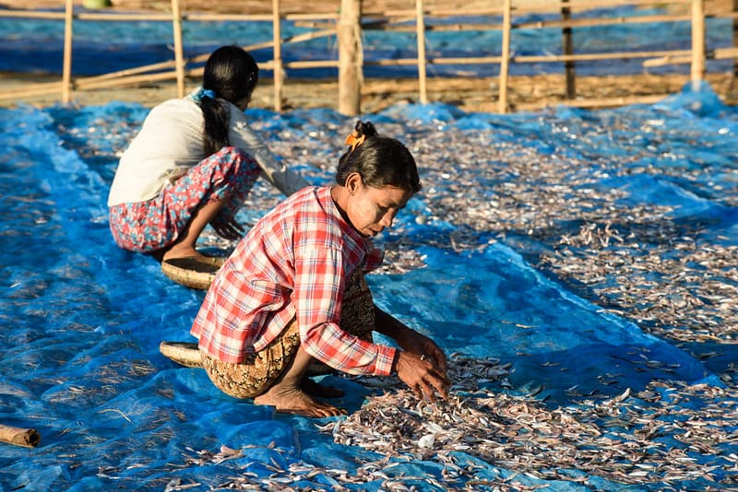
Challenges Faced
Environmental : Overfishing: IUU trawling & declining stocks (e.g., Hilsa -40%).
Habitat Loss: 50% mangroves destroyed; coral bleaching
Climate Change: Cyclones, saline intrusion
Economic : Poverty: Middlemen pay 30% market price; fuel costs ↑200%.
Post-Harvest Losses: 30% spoilage (no cold storage).
Limited access to markets
Governance : Weak Enforcement for Illegal Fishing: Fisheries Law, No SSF-specific law
Social : Gender Gap: Women do 70% work but own <10% boats.
Youth: Traditional knowledge lost.

Slide 8
Requirements
Government or International organization provides technical and financial support schemes
Training programs focus on sustainable fishing practices
International projects assist with research and monitoring
Capacity-building is key for long-term development

Slide 9
Opportunities for Improvement
Community-based management can enhance sustainability
Introducing eco-friendly gear reduces environmental damage
Market access and value chains can be improved
Data collection and monitoring should be implemented

Slide 10
Conclusion
Small-scale fisheries are vital for Myanmar’s development
Balancing economic and environmental goals is a top priority
Multi-stakeholder engagement is needed for effective management
Future policies must support inclusive and sustainable practices
Willing to cooperate with internal and external agencies

Slide 11
Rreferences
Department of Fisheries, Myanmar. (2024). Annual Fisheries Statistics Report.
FAO. (2022). Small-Scale Fisheries in Asia: Status and Challenges. Food and Agriculture Organization of the United Nations.
SEAFDEC. (2023). Regional Guidelines for Responsible Fisheries in Southeast Asia.
World Bank. (2020). Myanmar Sustainable Fisheries Development Project Report.
GEF/UNDP. (2021). Supporting Coastal and Marine Fisheries in Myanmar.

Slide 12
Thank You for Your Kind Attention

