Slide 1
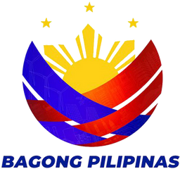
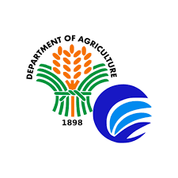
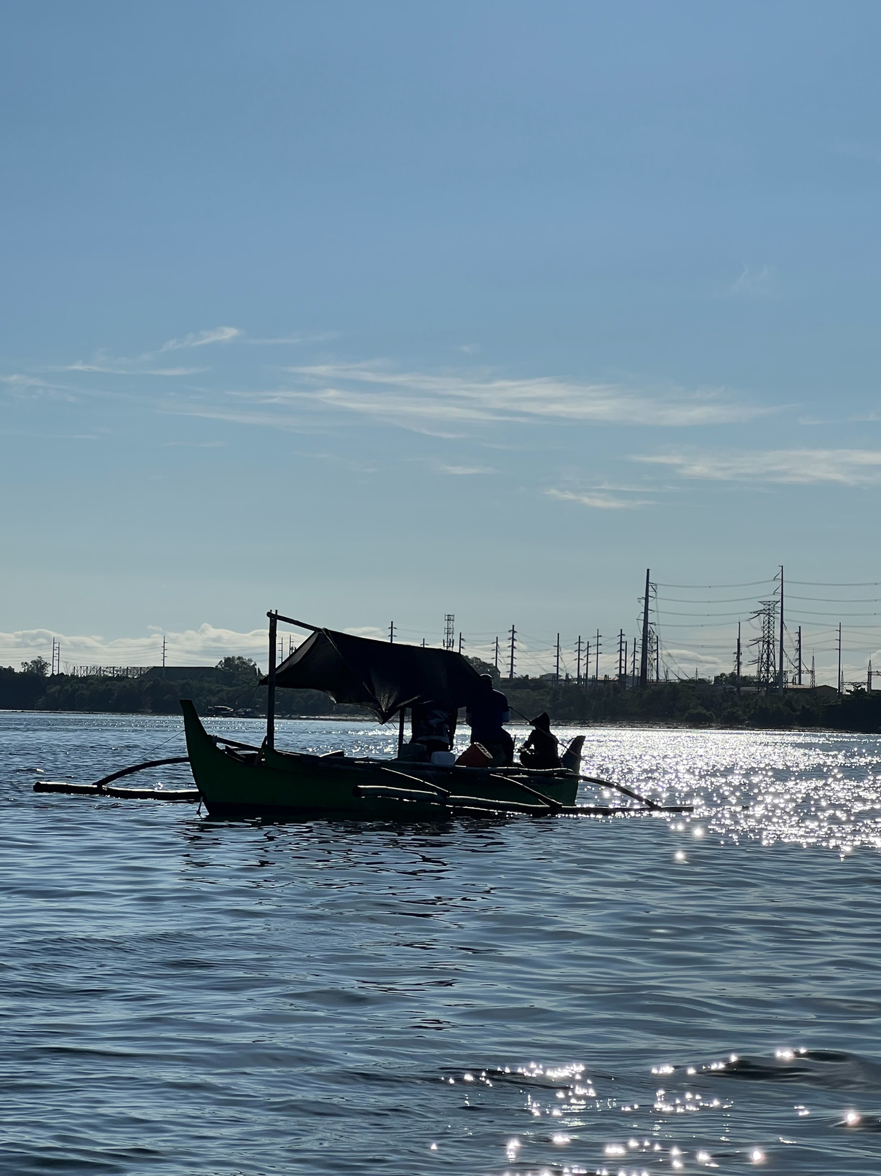

Department of Agriculture
NATIONAL FISHERIES RESEARCH AND DEVELOPMENT INSTITUTE
COUNTRY REPORT
SMALL-SCALE FISHERIES IN THE PHILIPPINES:
STATUS AND CHALLENGES
Luz Romena and Renalyne Acosta
July 14-17, 2025
Bangkok, Thailand

Slide 2

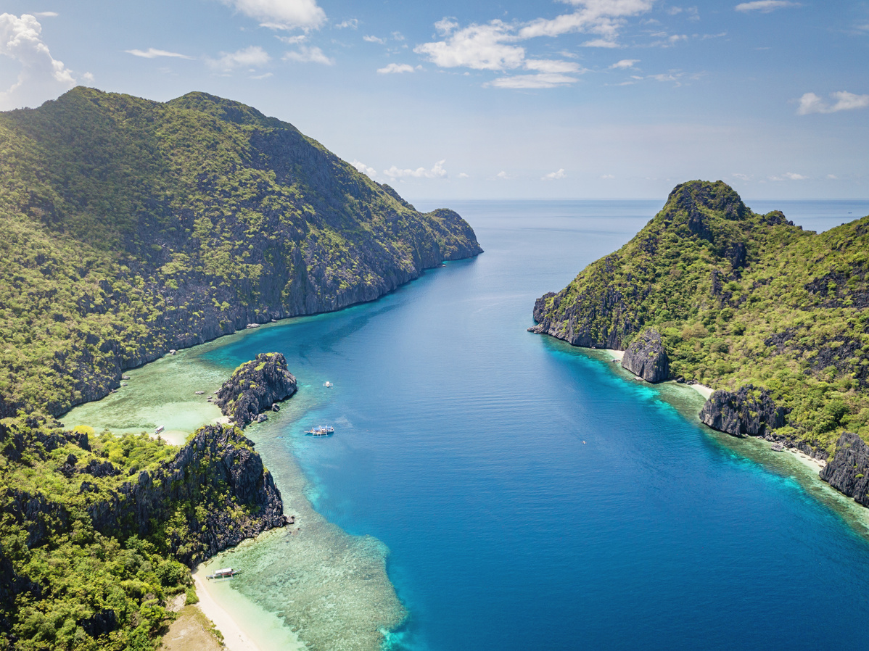
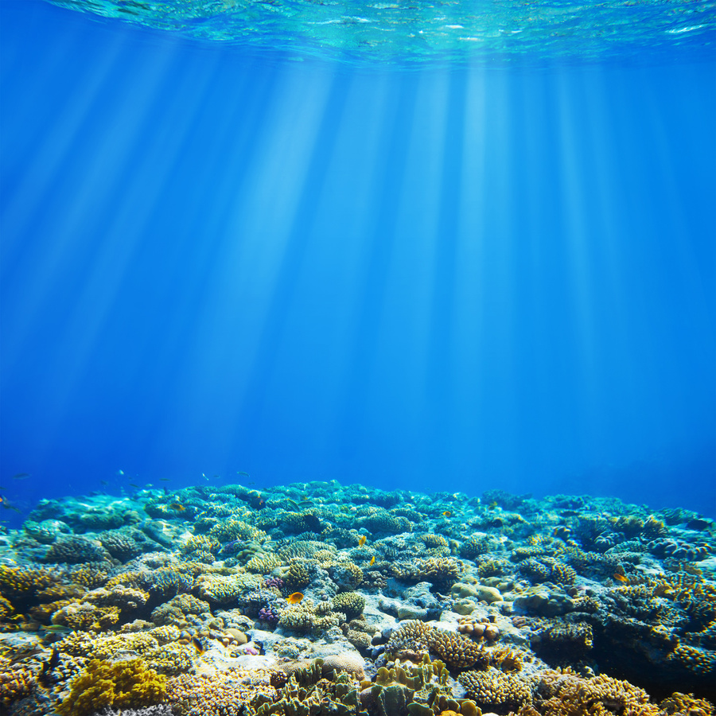
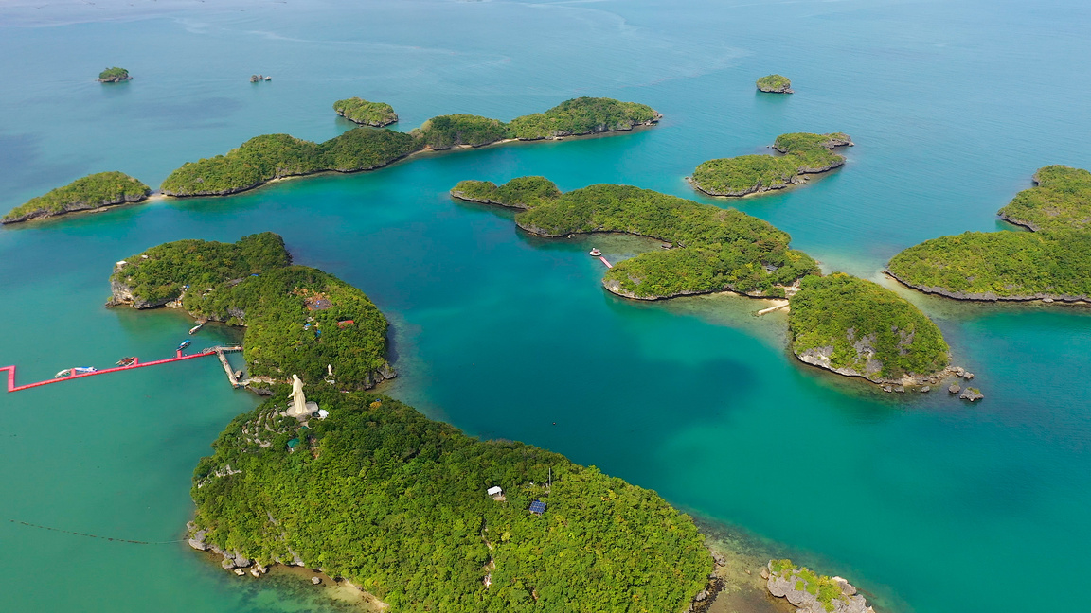
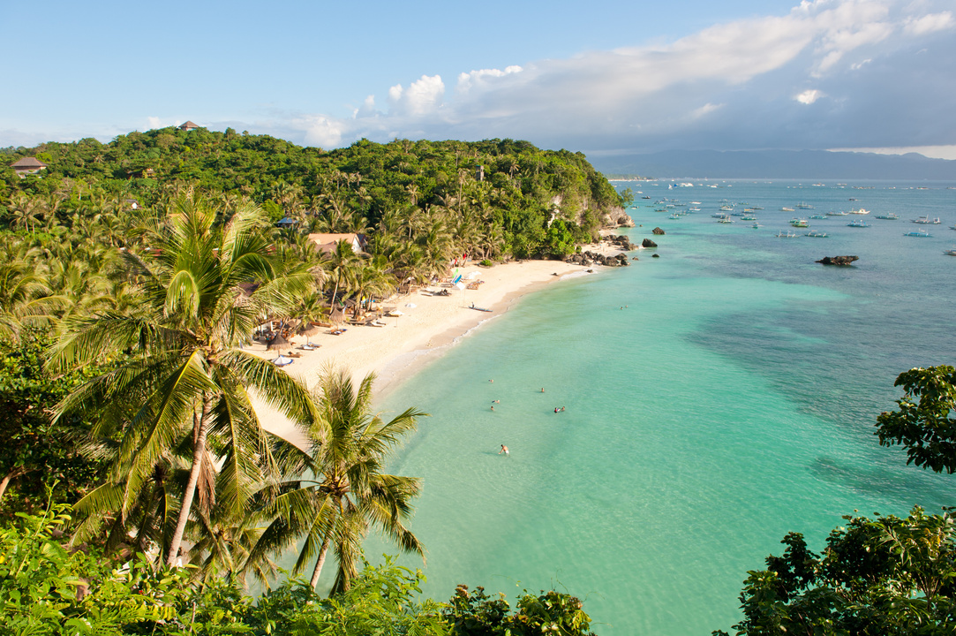
OVERVIEW: PHILIPPINE PROFILE
  Geographically located at the apex of the Coral Triangle – Center of Marine Biodiversity
  coral reef area of roughly 27,000 km2
  76% of the world’s coral species live (at least 500 species of corals), and home to at least 2,228 species of reef fish
total territorial (marine) water area of about 2,200,000 km2, including the exclusive economic zone (EEZ),
2nd largest archipelagic country in the world with 7,641 islands (MANA) Maritime and Archipelagic Nation
5th longest coastline in the world - 36,289 km

Slide 3
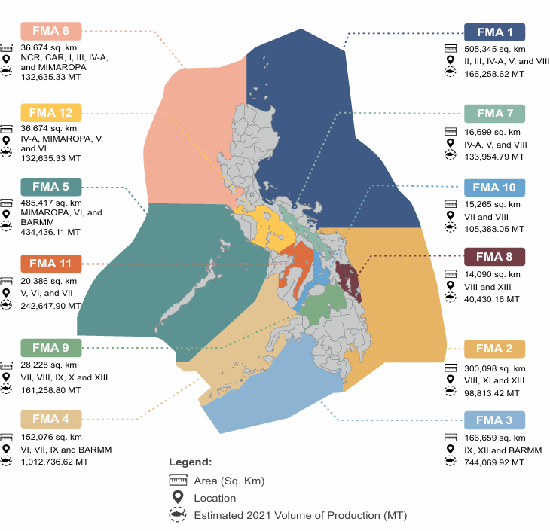

OVERVIEW: PHILIPPINE PROFILE
The fishing areas of the Philippines are strategically divided into 12 Fisheries Management Areas (FMAs) based on Fisheries Administrative Order (FAO) 263.

Slide 4
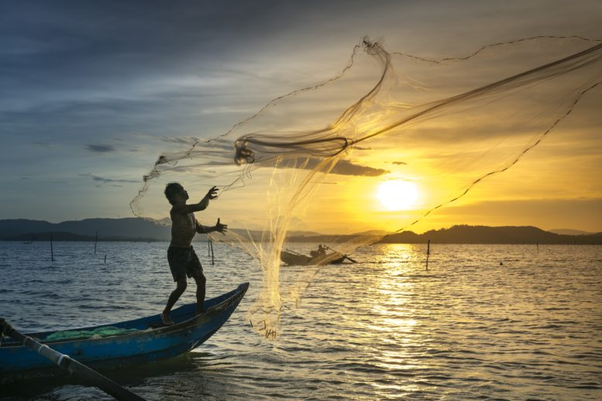
PHILIPPINE FISHERIES PROFILE
Philippines remained as the 11th largest fish-producing country in the world, with a total production of 4.12 million MT of fish, crustaceans, molluscs, and aquatic plants (including seaweeds) in 2022 (FAO)
accounted for 1.9% of the global production volume
Aquaculture: Philippines ranked 12th in the world, contributing 804,292.15 MT or 0.9% of the total global aquaculture production
Furthermore, the Philippines ranked 4th as the world’s largest producer of aquatic plants (including seaweeds), with a total of 1.55 million MT or 4.1% of the total world production

Slide 5
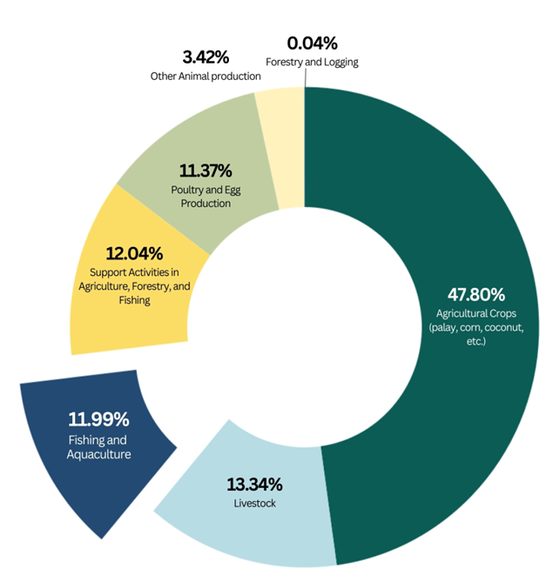
CONTRIBUTION TO ECONOMY
Total Fisheries Production
valued at PhP 328.74 billion (2023)
Fishing and Aquaculture activities
PhP 274 billion or 12.0% of the Gross Value Added (GVA)
Agriculture, Forestry, and Fishing (AFF) sector contribution to the total GVA

Slide 6
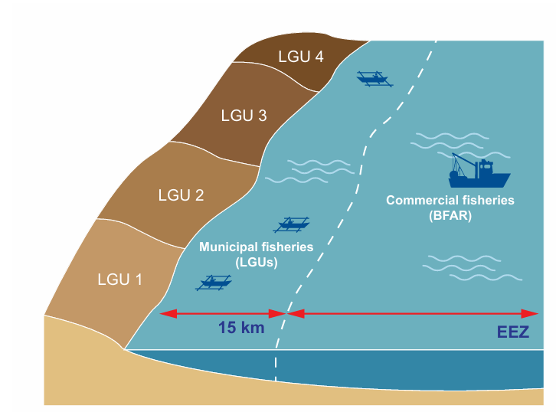
SMALL-SCALE FISHERIES IN THE PHILIPPINES
MUNICIPAL FISHERIES
capture fishing activities carried out using fishing vessels weighing 3 gross tons (GT) or less
SMALL-SCALE COMMERCIAL FISHERIES
use passive or active gear and involve vessels of 3.1–20 GT
Fisheries management areas as defined by RA 8550

Slide 7
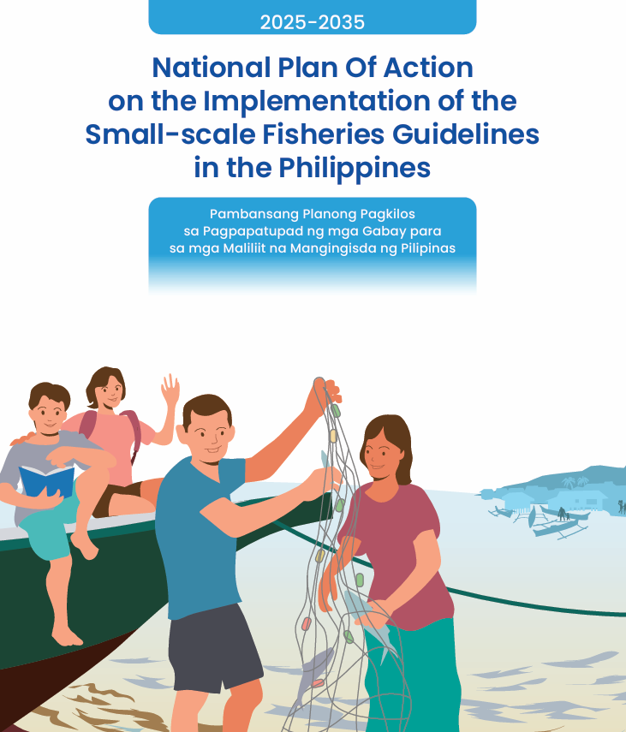

SMALL-SCALE FISHERIES IN THE PHILIPPINES
National Plan of Action for Small-Scale Fisheries (NPOA SSF)
  result of a participatory and inclusive process that engaged relevant stakeholders across the country . (250 key stakeholders, 6 consultative workshops)
  National Technical Working Group (NTWG), which comprised representatives from DA-BFAR, DILG-BLGS, UN-FAO, NAPC, NCIP, fisherfolk leaders across the country, small-scale processors, Indigenous Peoples, women’s organizations, NGOs, and the academe
FIRST IN ASIA

Slide 8
National Plan of Action for Small-Scale Fisheries (NPOA SSF)
  The NPOA SSF was formulated under the FAO’s Voluntary Guidelines for Securing Sustainable Small-Scale Fisheries in the Context of Food Security and Poverty Eradication.
  These guidelines address policies, strategies, and legal frameworks concerning small-scale fisheries, as well as other matters affecting livelihoods in fishing communities.

Slide 9
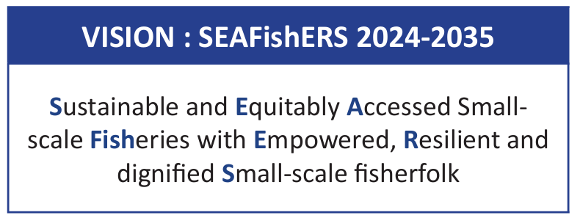
National Plan of Action for Small-Scale Fisheries (NPOA SSF)

Slide 10

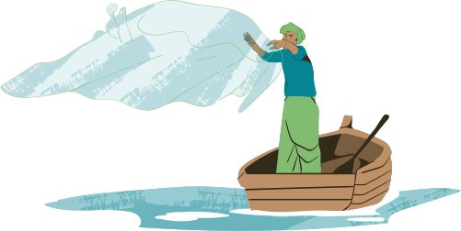
THE CHALLENGES THAT CONFRONT THE SMALL-SCALE FISHERIES SECTOR ARE GROUPED PER THEMATIC AREA
Governance of tenure, sustainable resource management, and policy coherence
  Conflicting policy issuances by National Government Agencies
  Weak implementation of fishery and environmental laws and policies at the local government level.
  Deprivation of Indigenous Peoples of their tenurial rights over ancestral waters

Slide 11
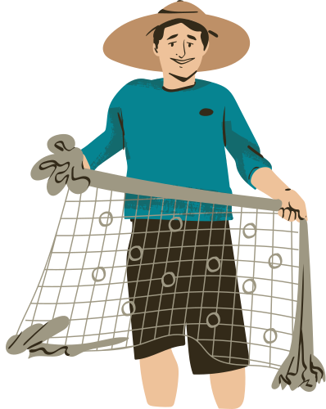
THE CHALLENGES THAT CONFRONT THE SMALL-SCALE FISHERIES SECTOR ARE GROUPED PER THEMATIC AREA
Social development, employment, and decent work
  Employment in the SSF sector is generally diverse, informal, and not homogenous
  Fisherfolks still experience marginalization and high poverty rates
  Access to social protection services generally remains low among SSF

Slide 12
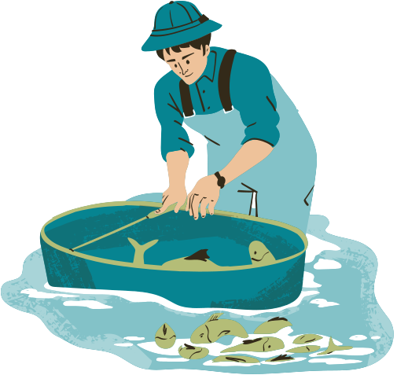
THE CHALLENGES THAT CONFRONT THE SMALL-SCALE FISHERIES SECTOR ARE GROUPED PER THEMATIC AREA
Value chains, post-harvest, and trade
  Contribution and participation of some of the SSF key players (e.g., pre-harvest actors and women across the value chain) are often undervalued and unrecognized
  SSF remains to be challenged by limited access to appropriate technologies, best practices, infrastructures, and fair trade.

Slide 13
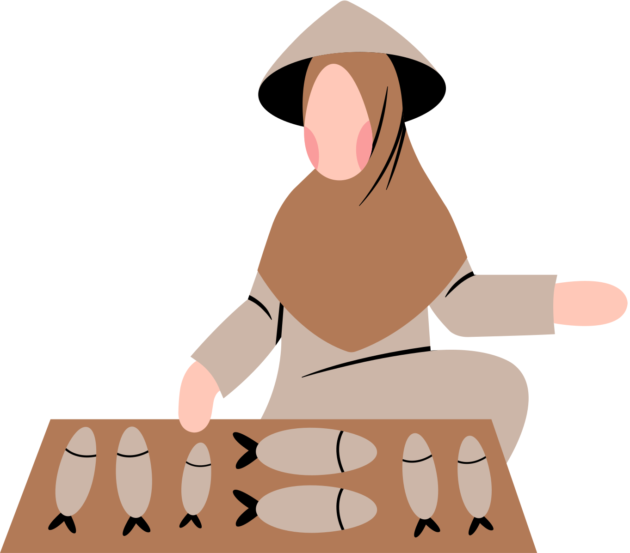
THE CHALLENGES THAT CONFRONT THE SMALL-SCALE FISHERIES SECTOR ARE GROUPED PER THEMATIC AREA
Gender Equality
  Women in the SSF sector are underrepresented in the fisherfolk registry, their contributions and roles are not being adequately recognized, their needs are often overlooked, and they have marginal participation in decision-making in programs, activities, and policies

Slide 14
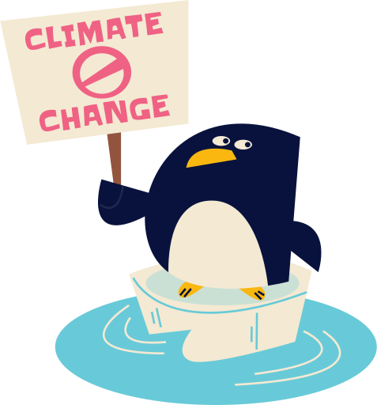
THE CHALLENGES THAT CONFRONT THE SMALL-SCALE FISHERIES SECTOR ARE GROUPED PER THEMATIC AREA
Disaster risks and climate change
  Philippines is the country most at risk from multiple climate hazards, including extreme weather, rising sea levels, increasing ocean temperatures, and acidification, all threatening critical habitats such as coral reefs.
  SSF is a high-risk profession where safety at sea and other social protection mechanisms are either substandard or absent, such as the lack of safety gear and adequate insurance for fishers, boats, and fishing gear.

Slide 15
ULTIMATE GOAL
NPOA-SSF has outlined the activities, interventions, policies, and strategies, among other things, that will be implemented to fully address the above issues and challenges and improve the SSF sector
NPOA SSF aims to uplift the lives of small-scale fishers, a sector often marginalized, poor, and disadvantaged, by ensuring their voices are heard, their needs addressed, and their human and tenurial rights recognized and respected
THIS PLAN IS TO BE IMPLEMENTED FROM 2025 TO 2035

Slide 16

Department of Agriculture
NATIONAL FISHERIES RESEARCH AND DEVELOPMENT INSTITUTE
THANK YOU

