Slide 1
Status and challenges of small - scale fisheries in Thailand
By Ms. WARAPORN DECHBOON

Slide 2
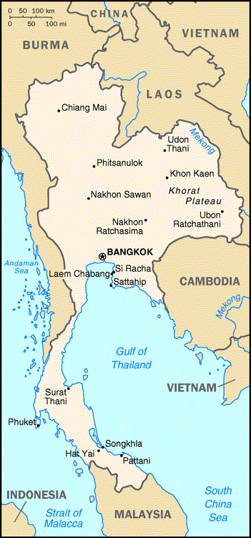
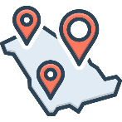
General Information
Total land area: 514,000 km²
Including 77 provinces
Population: 65.95 million
Coastal small-scale fisheries: along 2,614 km coastline of 24 provinces with 2 sites; Gulf of Thailand and Andaman Sea
Inland small-scale fisheries are found along rivers, lakes or swamps

Slide 3
Gross domestic product (GDP)
Gross domestic product (GDP) of Thailand was estimated at 7,496.0 $ per capita in 2024. Agriculture, forestry and fishing contributed only 8.8 % to GDP.

Slide 4
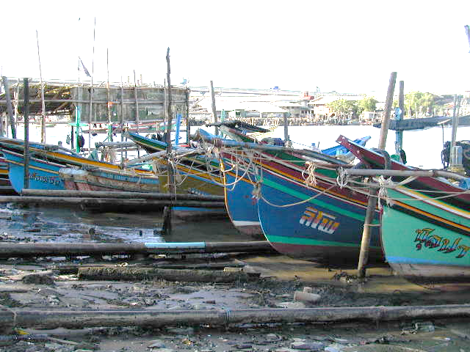
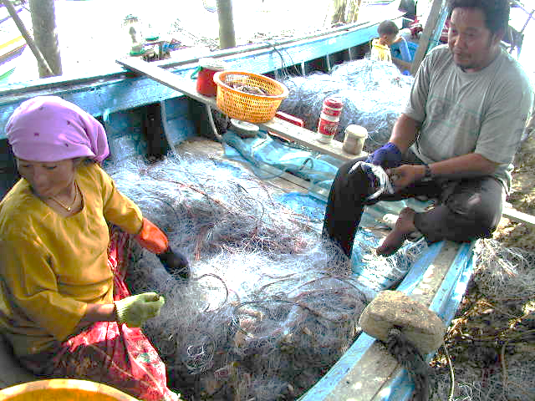
SSF are officially defined in the 2015 Royal Ordinance on Fisheries (Royal Gazette, 2015a) under two main categories:
1) “Artisanal fishing” means fishing operations in “coastal seas” in which a fishing vessel is used or in which a fishing gear is used without a fishing vessel, but in any case, does not include commercial fishing; and
2) “Coastal seas” means areas within 3 nautical miles from the baselines.
SSF in Thailand use a range of gear types and the majority of the small-scale fishing boats are wooden boats, with or without engine (outboard motor), For daily fishing trips. Vessels that are less than 10 GRT are considered small-scale.

Slide 5
Number of fishing boats by boat size in 2024

Slide 6
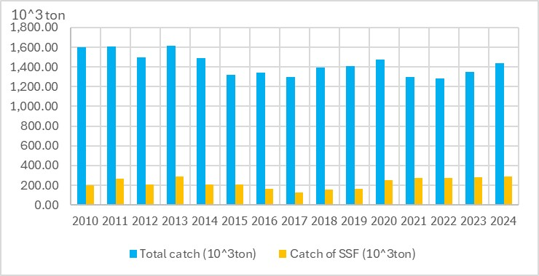
Catch of marine animal in 2010 - 2024

Slide 7
Catch of small scale fisheries in 2010 - 2024

Slide 8
Catch of marine animals from small - scale fisheries by group in 2024
jellyfish dip net
other dredges
squid trap
makerel gill net
sardine gill net
crab gill net
crab trap
shrimp trammel net

Slide 9
Fish Harvesting
In a typical SSF household, husband and wife work together to mend the fishing net. For families owning small fishing boats, women usually join a male relative on their daily fishing expeditions. At the end of the fishing trip, the groups return ashore to sort and process the daily catch for sale. Men and women work together to remove the fish from the net and to sell them in the markets, or do the preliminary processing before selling. For bigger boats requiring 3-4 crew members, women are usually not part of the fishing. Instead, they help with the postharvest process, during fish sorting and processing for sale. Many women are involved in the rudimentary processing of fish. Many of them are also in charge of the marketing and the trading of the catch, as well as work in bookkeeping and administration of the enterprises.

Slide 10
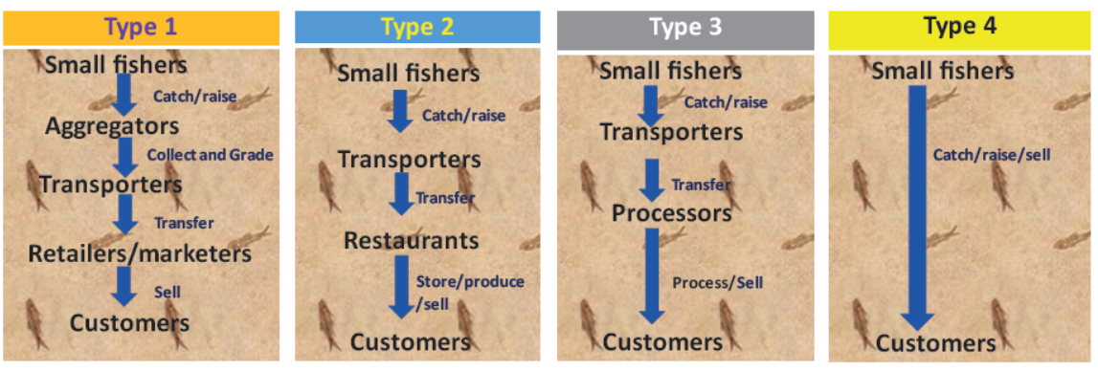
Value chain types

Slide 11
1. Fishery resources decline, and stakeholders’ conflicts are key sources of vulnerabilities. Fishery and other marine resources are degrading due to factors such as overfishing, destructive fishing practices, degraded coastal ecosystems, coastal development, pollution, and climate change.
2. Political dynamics are another source of SSF vulnerability.
3. Climate change is a major driver of SSF vulnerability. Sea level rises, ocean acidification and rising sea surface temperature have been observed in the coastal seas of Thailand, and linked to human activities.

